Slide 1






















WELCOME TO THE GREAT SALT LAKE SUMMIT
SPECIAL THANKS TO OUR SPONSORS!
MEAL SPONSORS:
VIDEO SPONSOR:
TABLE AND EXHIBIT SPONSORS:

Slide 2
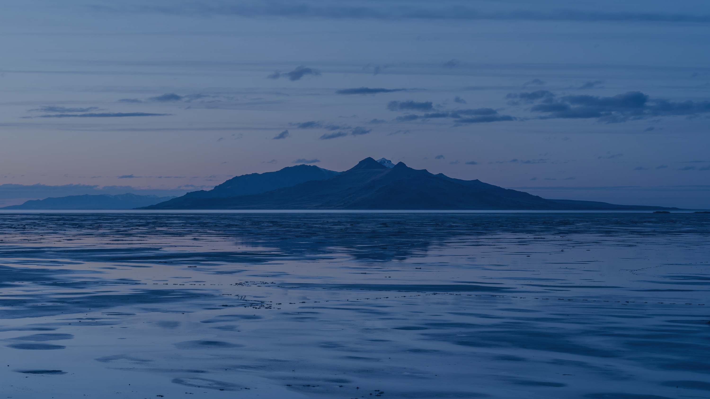
OCTOBER 13, 2022
GREAT SALT LAKE SUMMIT
Hosted by Speaker Brad Wilson

Slide 3
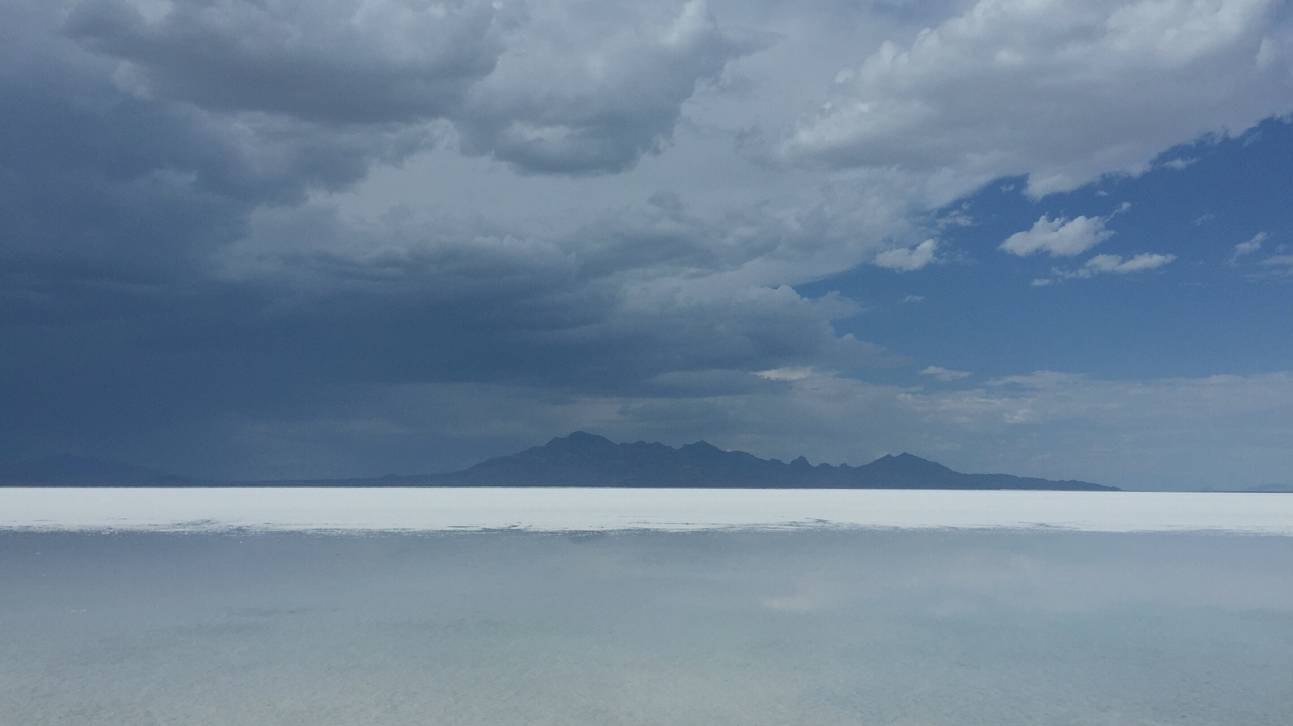
AGENDA
Exhibit Hall &
Continental Breakfast
BREAK
Welcome & Presentation:
What Have We Done?
Fireside Chat:
Challenges & Solutions
Speaker Brad Wilson
Speaker Brad Wilson
Rep. Tim Hawkes, Utah House
Joel Ferry, DNR
Overview of Utah Water Flows
Teresa Wilhelmsen
Utah State Engineer
Panel Discussion:
Federal Efforts
Utah Water Trends & Cycles
Moderator: Speaker Brad Wilson
Congressman Blake Moore (UT 1)
Senator Mike Lee (UT)
Senator John Barrasso (WY)
Brian Steed, Utah State University
William Anderegg, University of Utah
Panel Discussion:
The Lake Today
LUNCH
Moderator: Tage Flint
Jamie Barnes, DNR
Candice Hasenyager, DWR
Brian Steed, USU
Bart Forsyth, JVWCD
What's Next?
Speaker Brad Wilson

Slide 4
video here

Slide 5
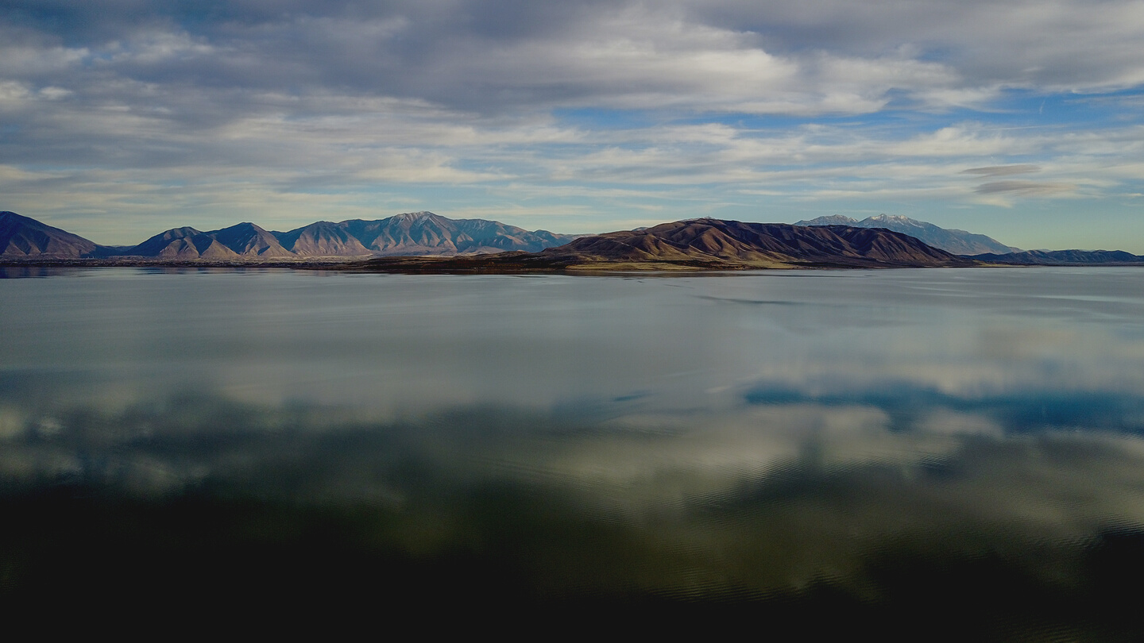
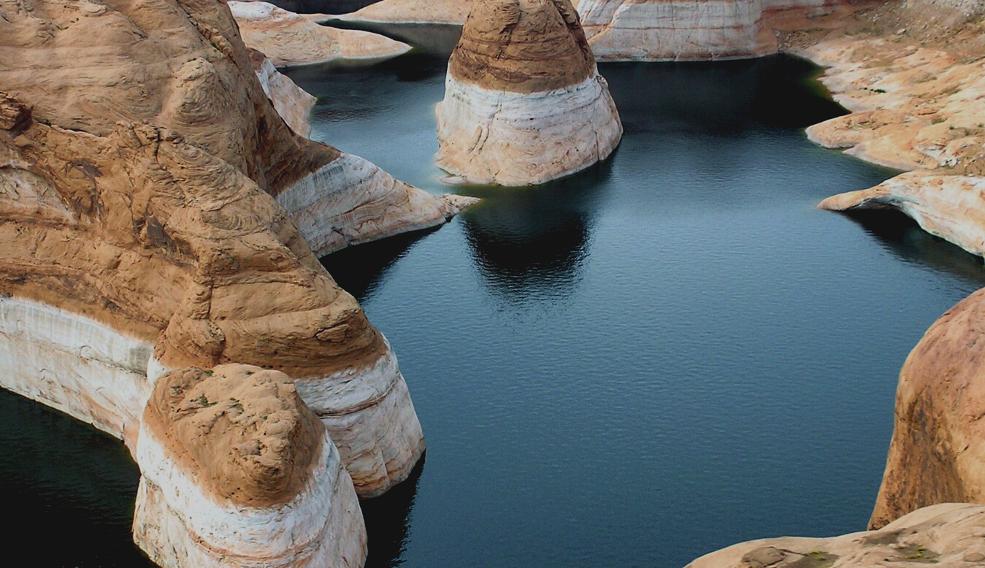
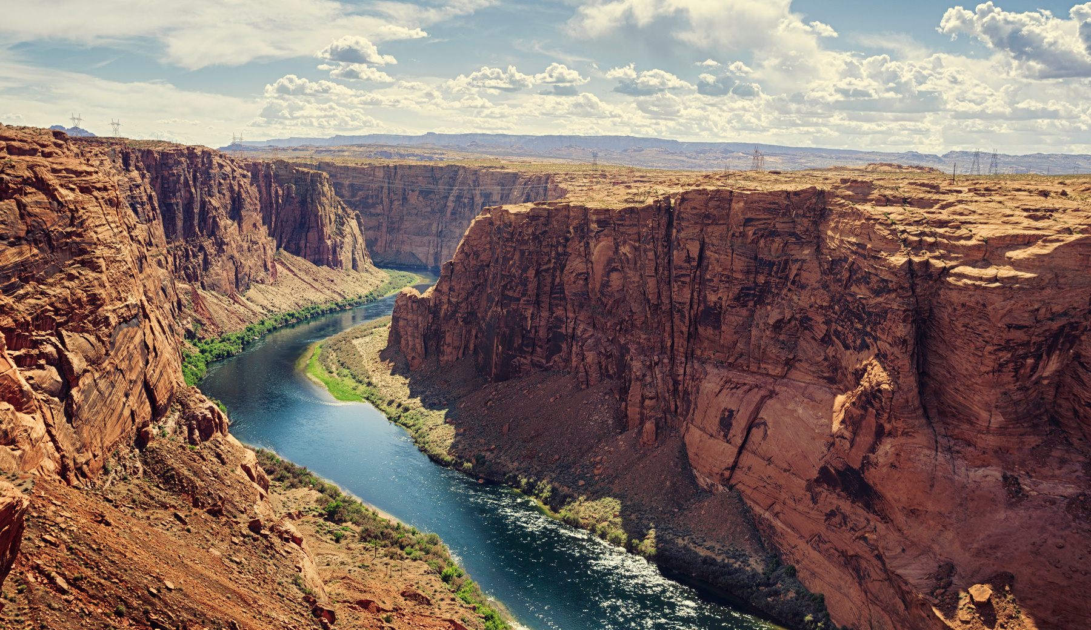
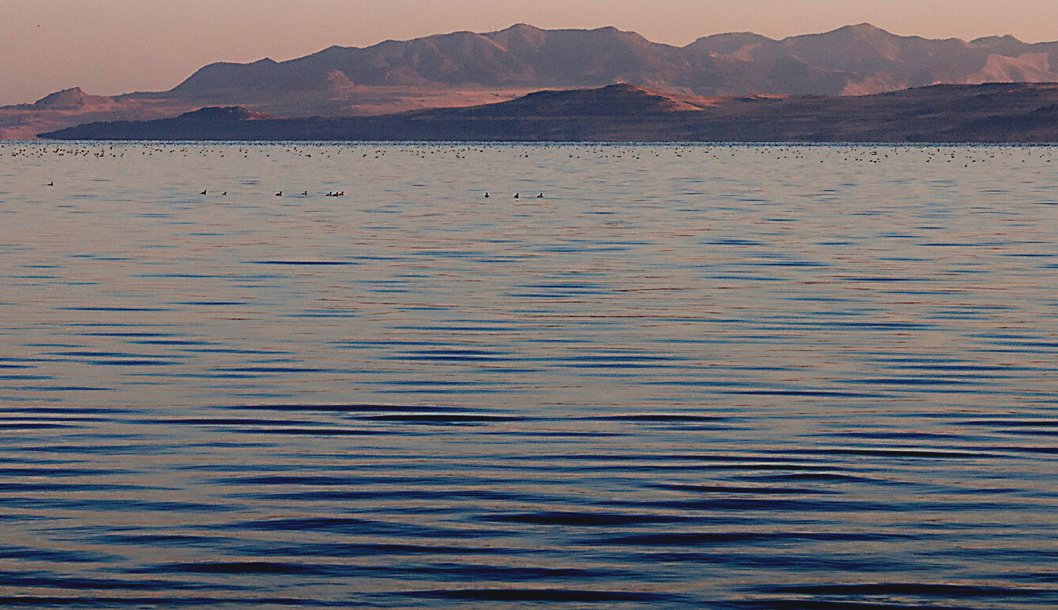
OVERVIEW OF UTAH'S WATER FLOWS
Teresa Wilhelmsen
Utah State Engineer

Slide 6
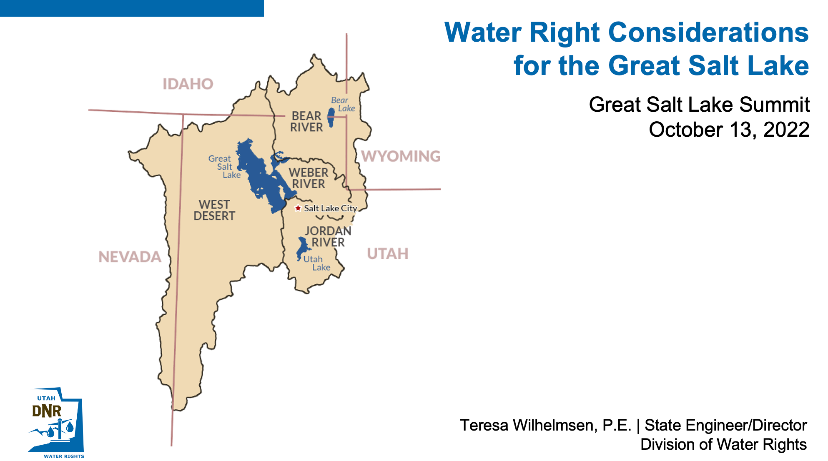

Slide 7


Slide 8
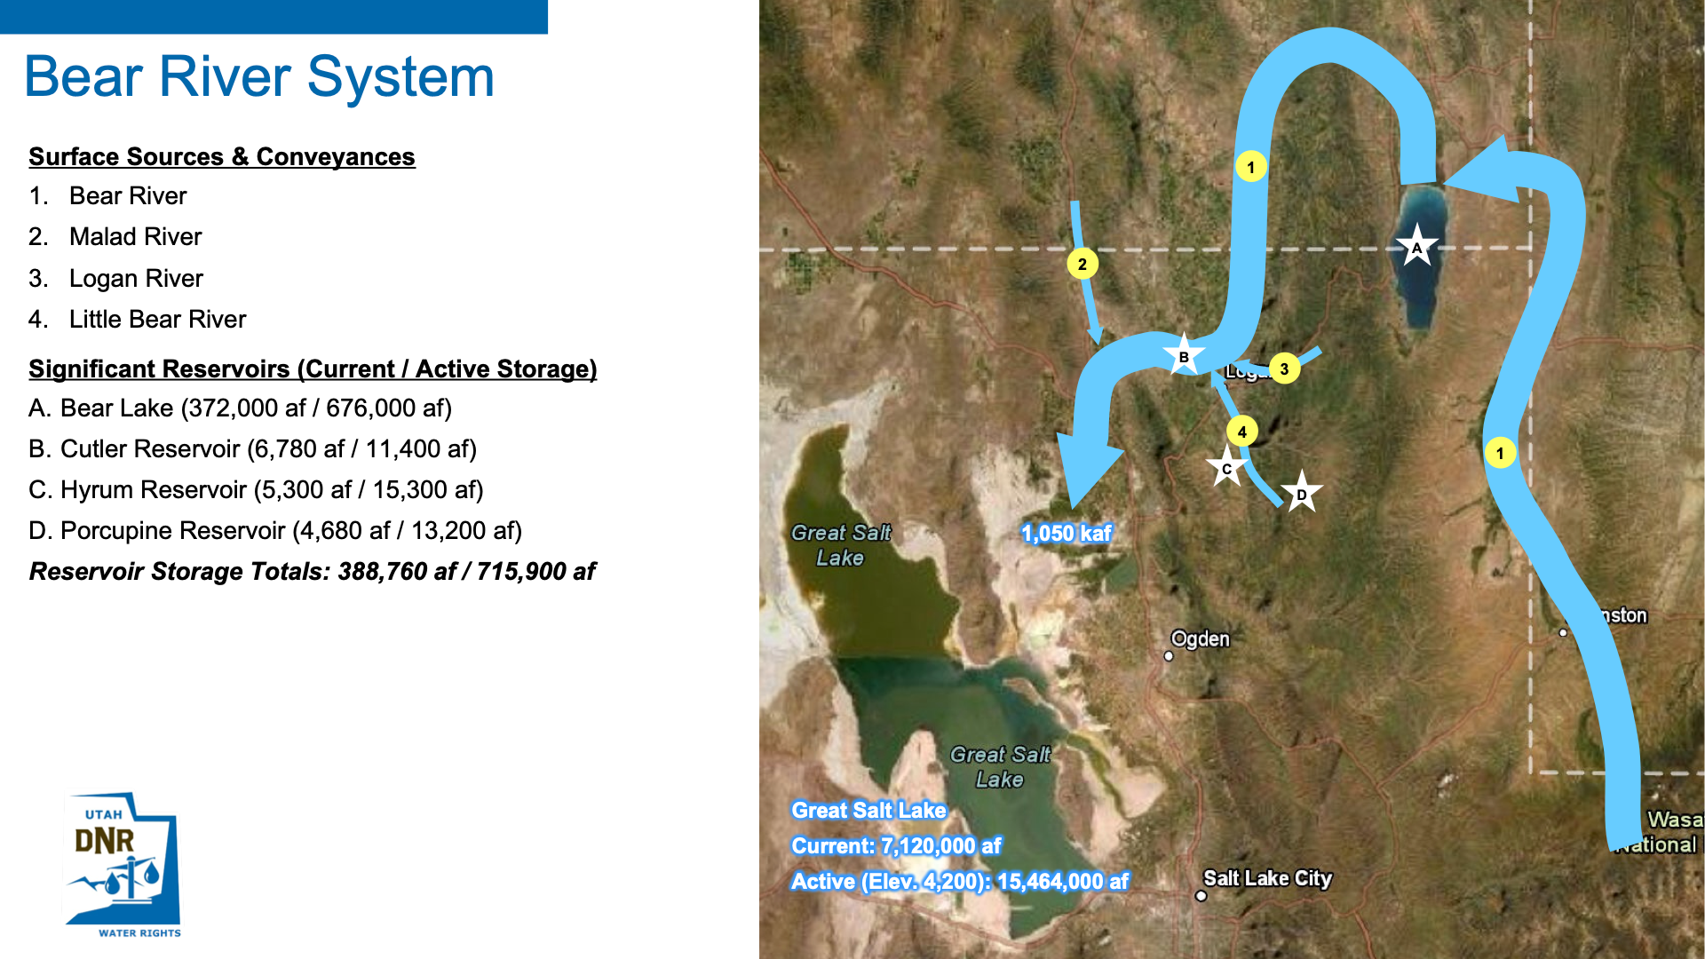

Slide 9
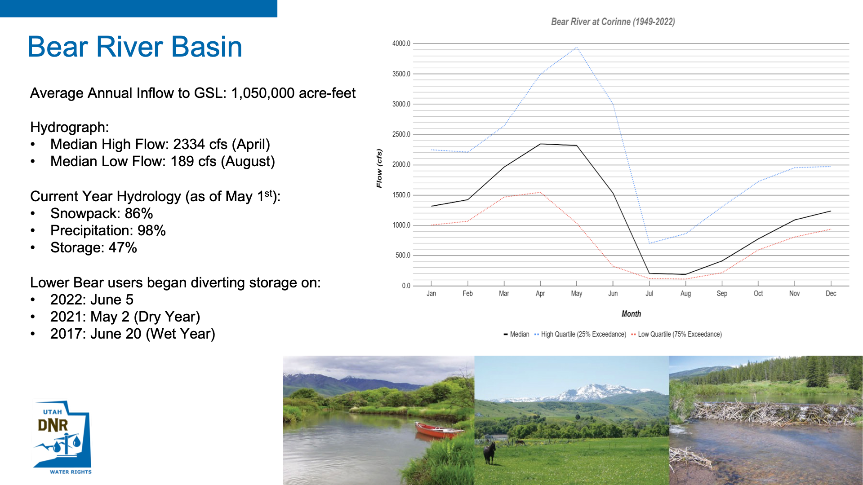

Slide 10
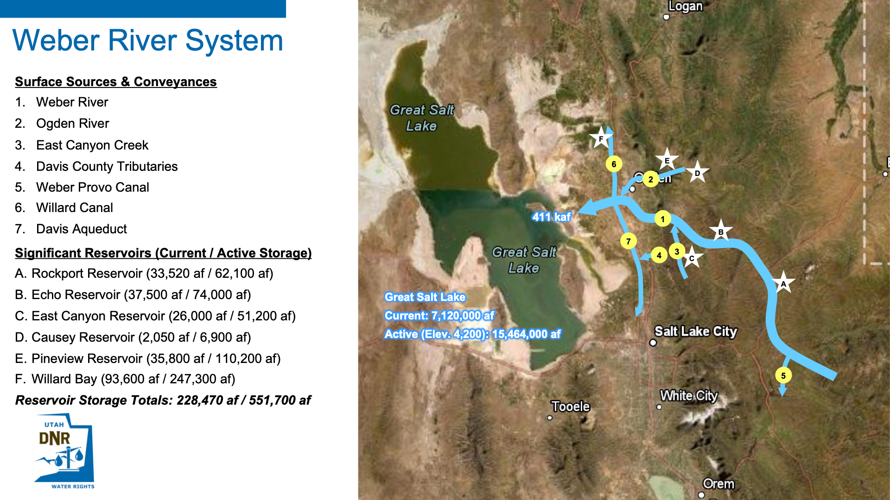

Slide 11
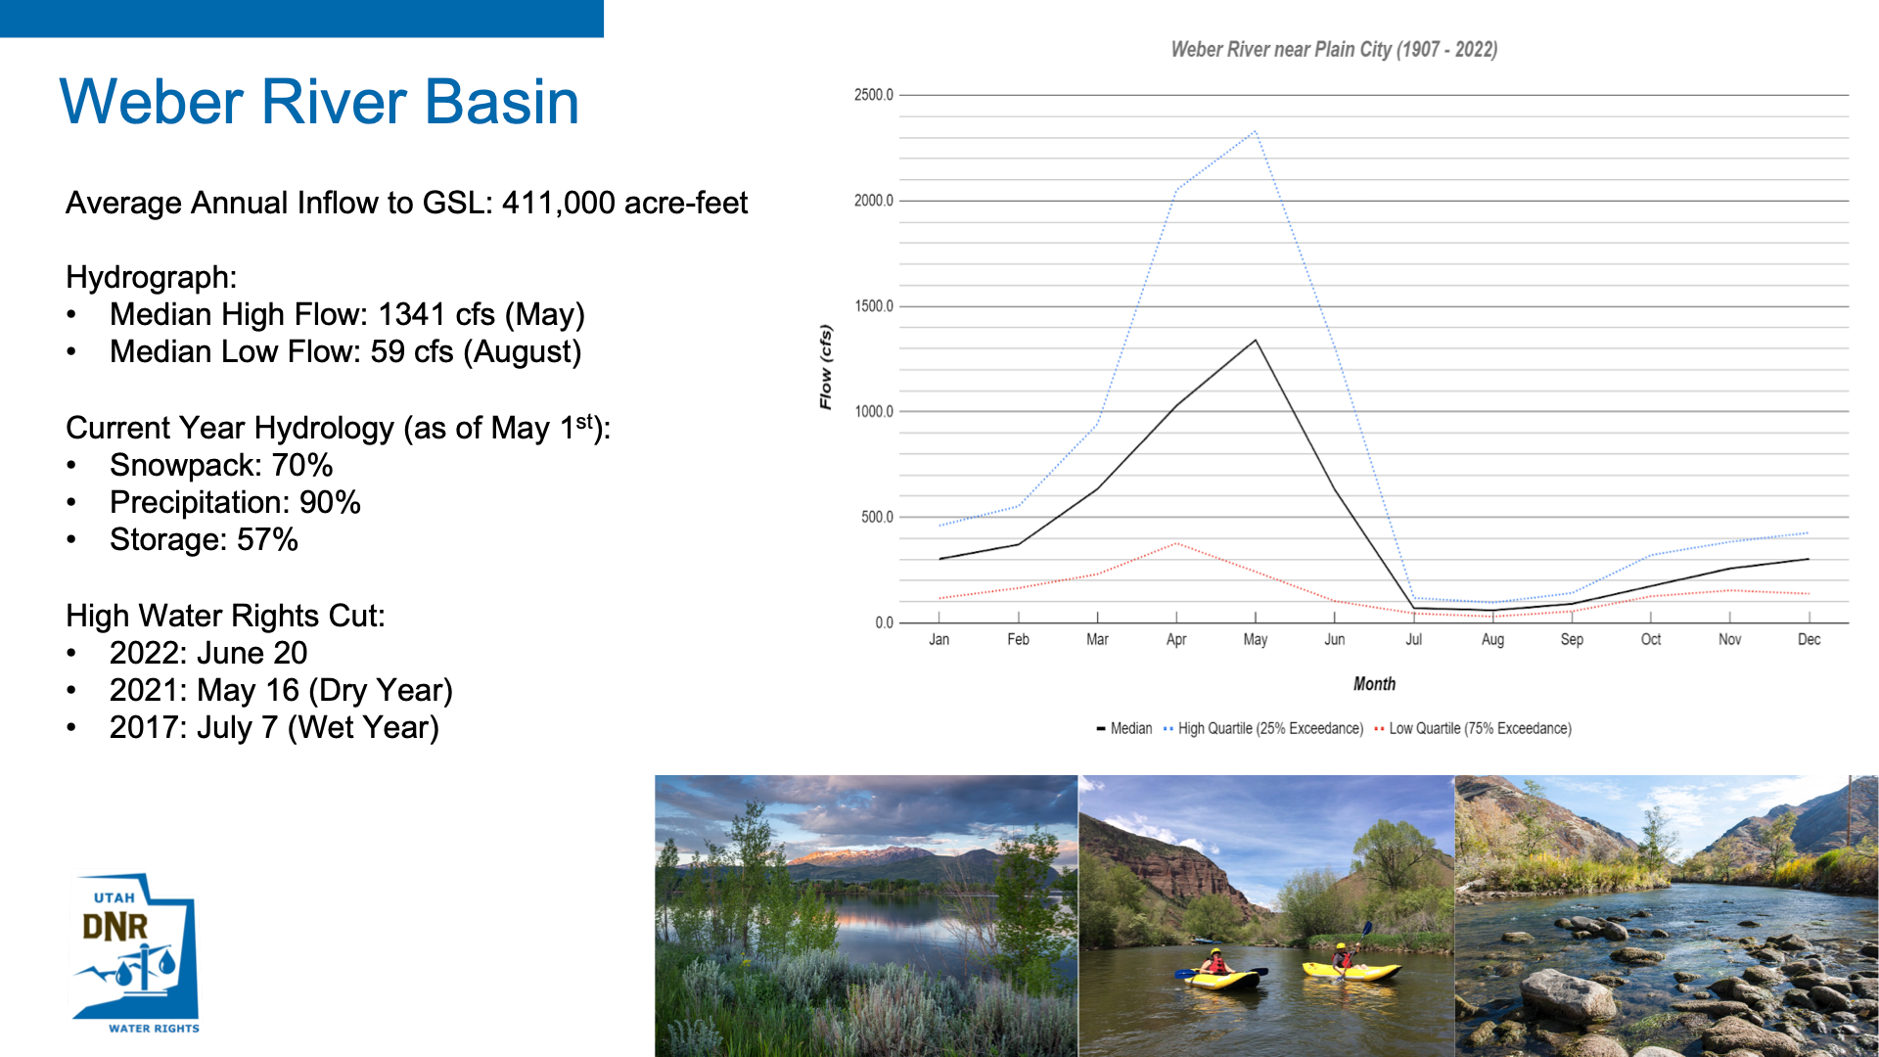

Slide 12
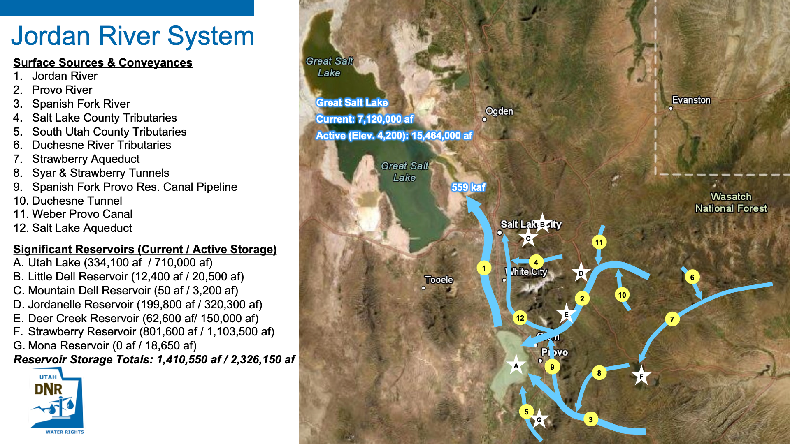

Slide 13
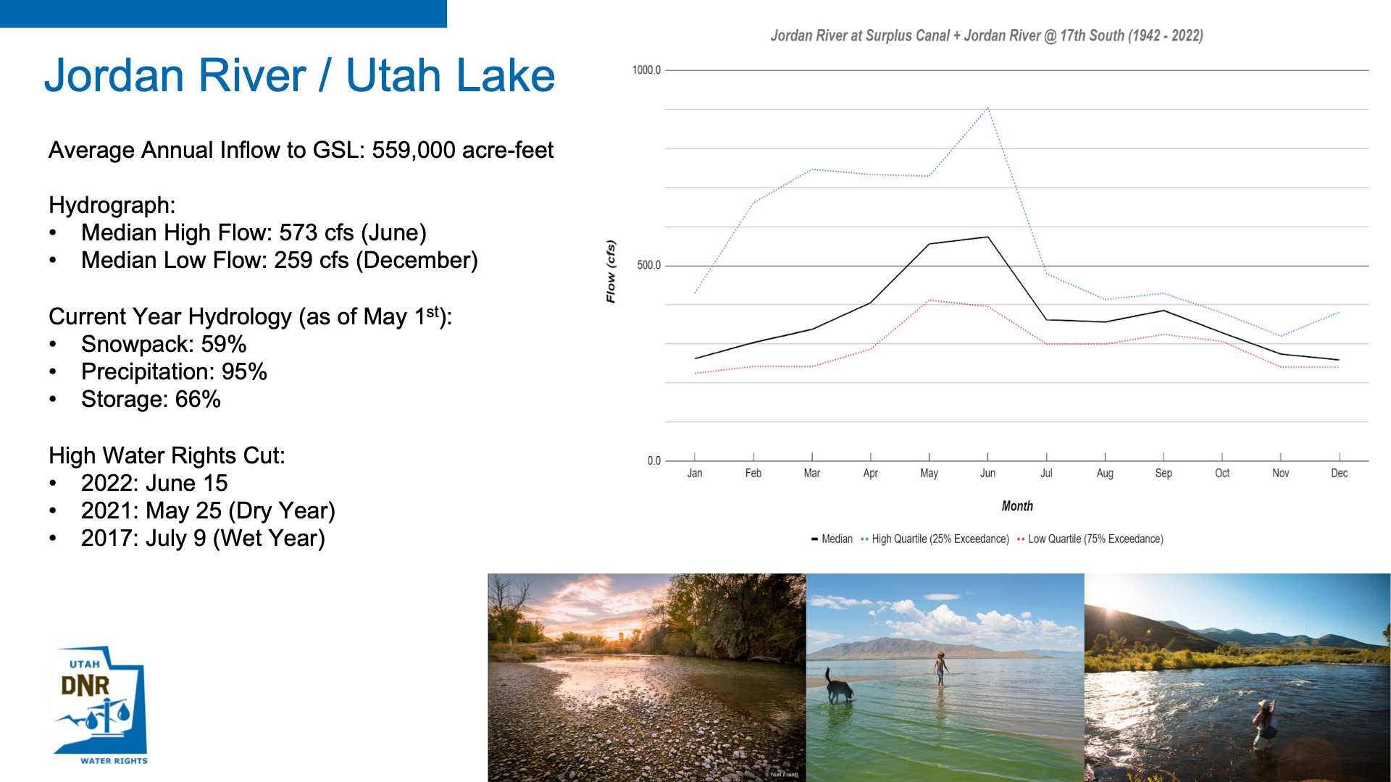

Slide 14
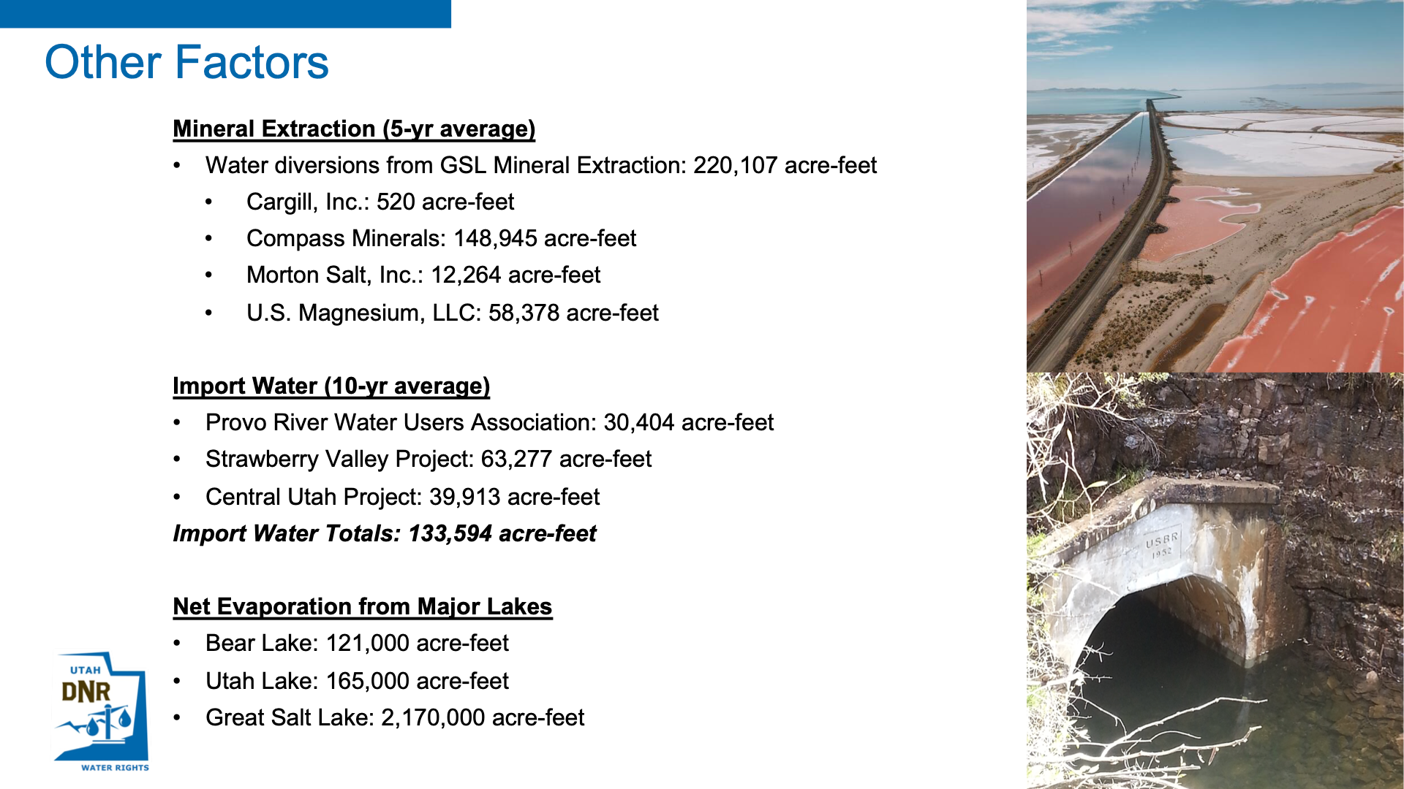

Slide 15
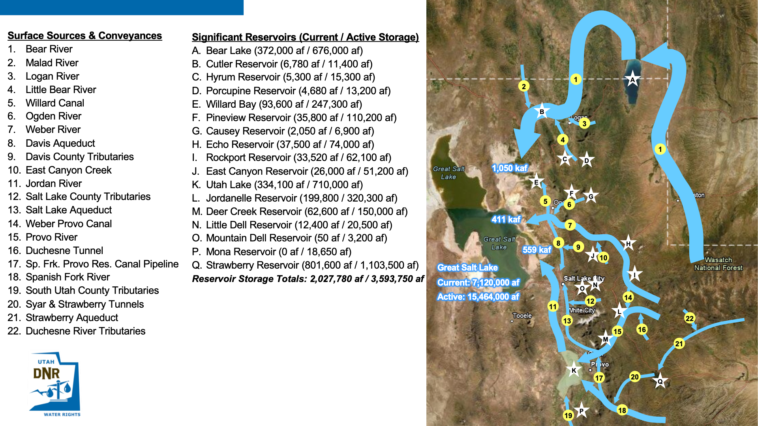

Slide 16
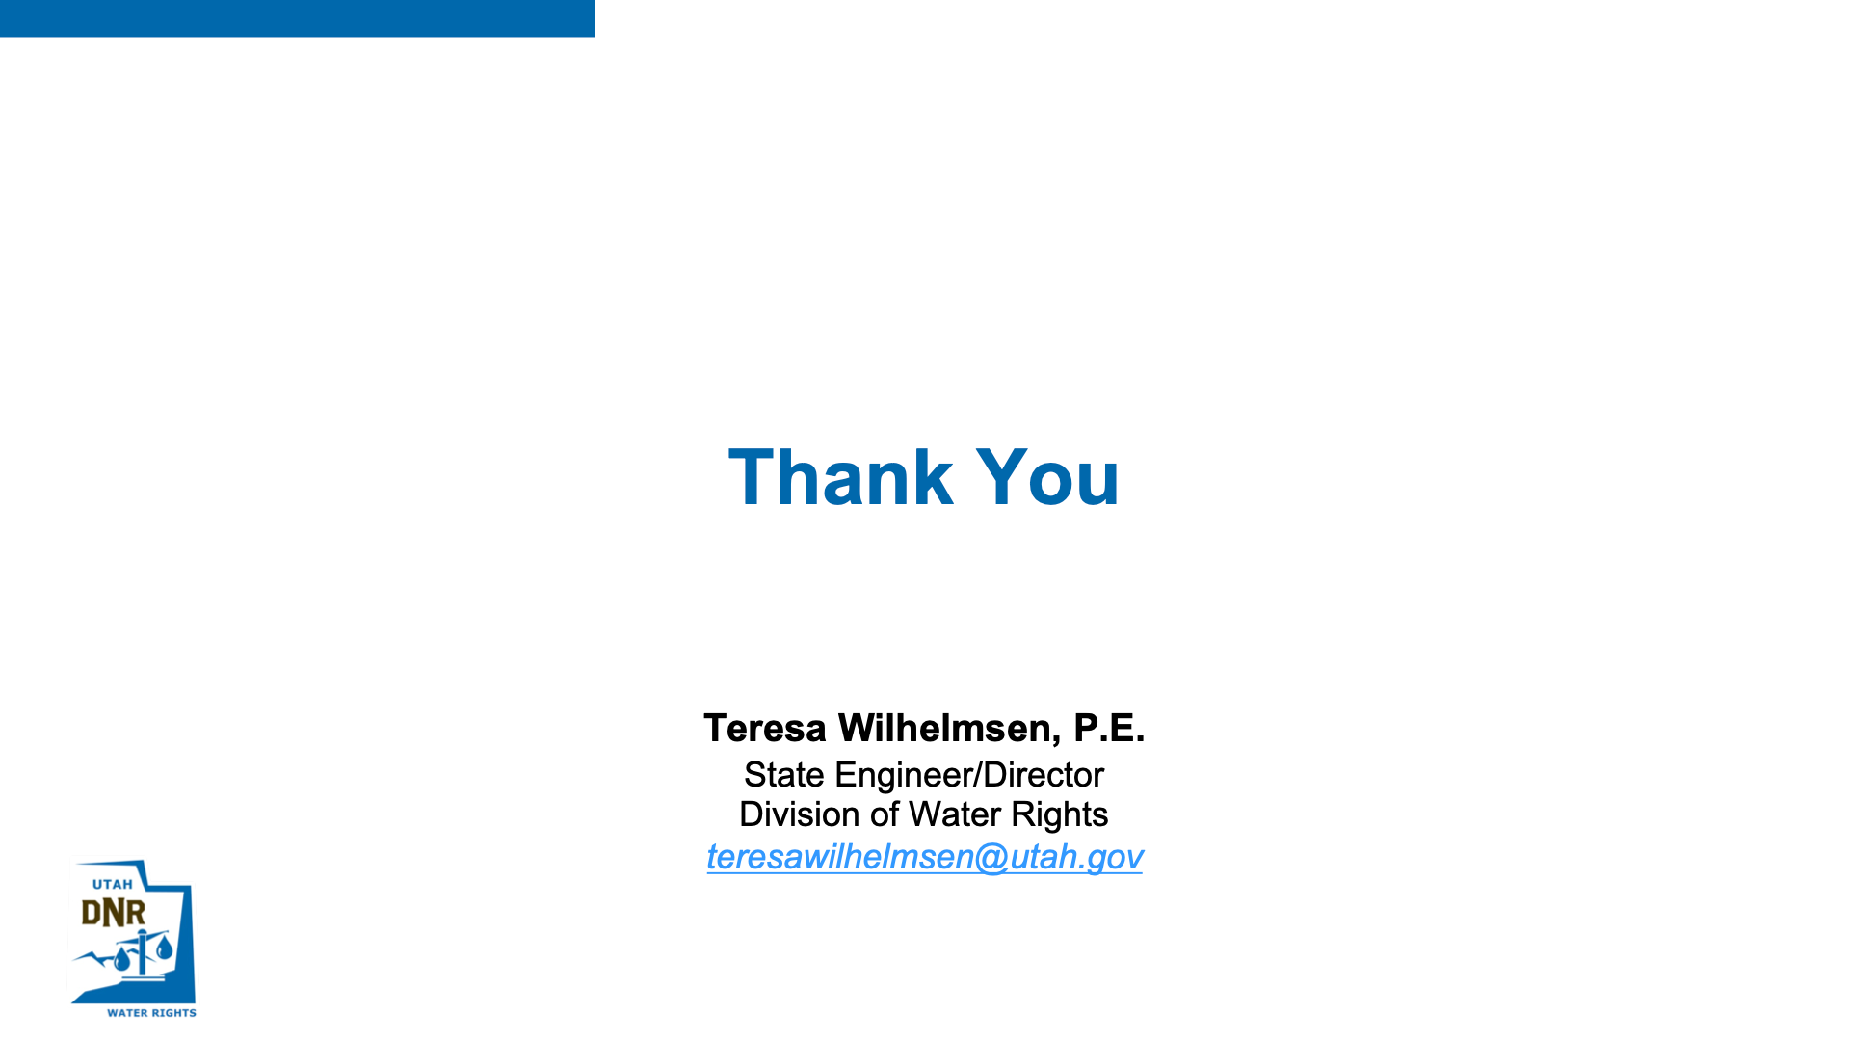

Slide 17
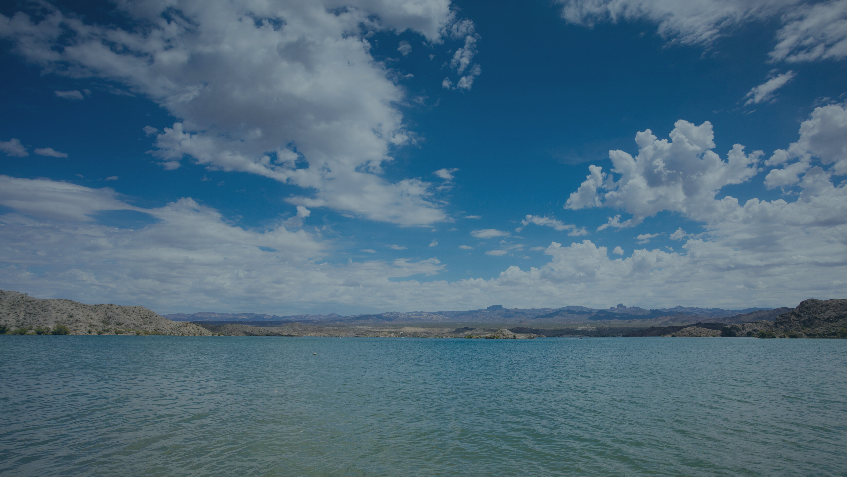
Utah Water Trends and Cycles
BRIAN STEED & WILLIAM ANDEREGG

Slide 18


Slide 19
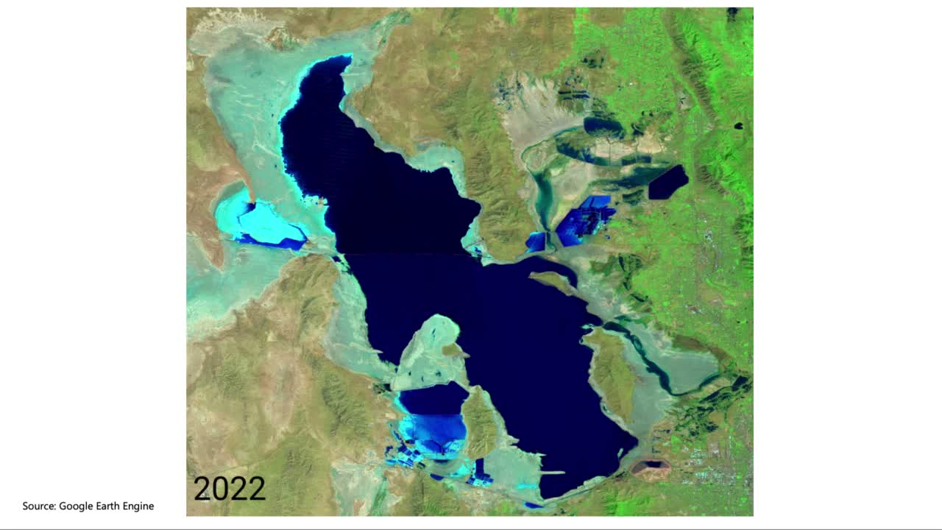

Slide 20
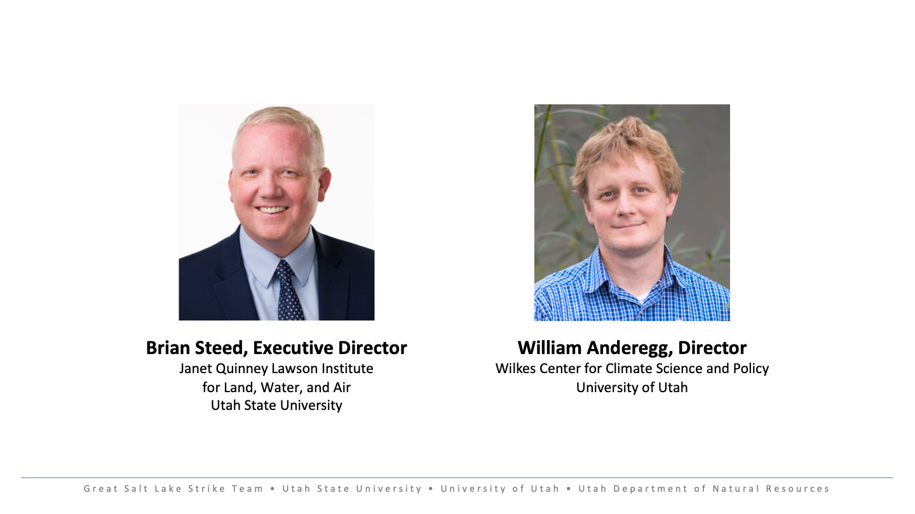

Slide 21
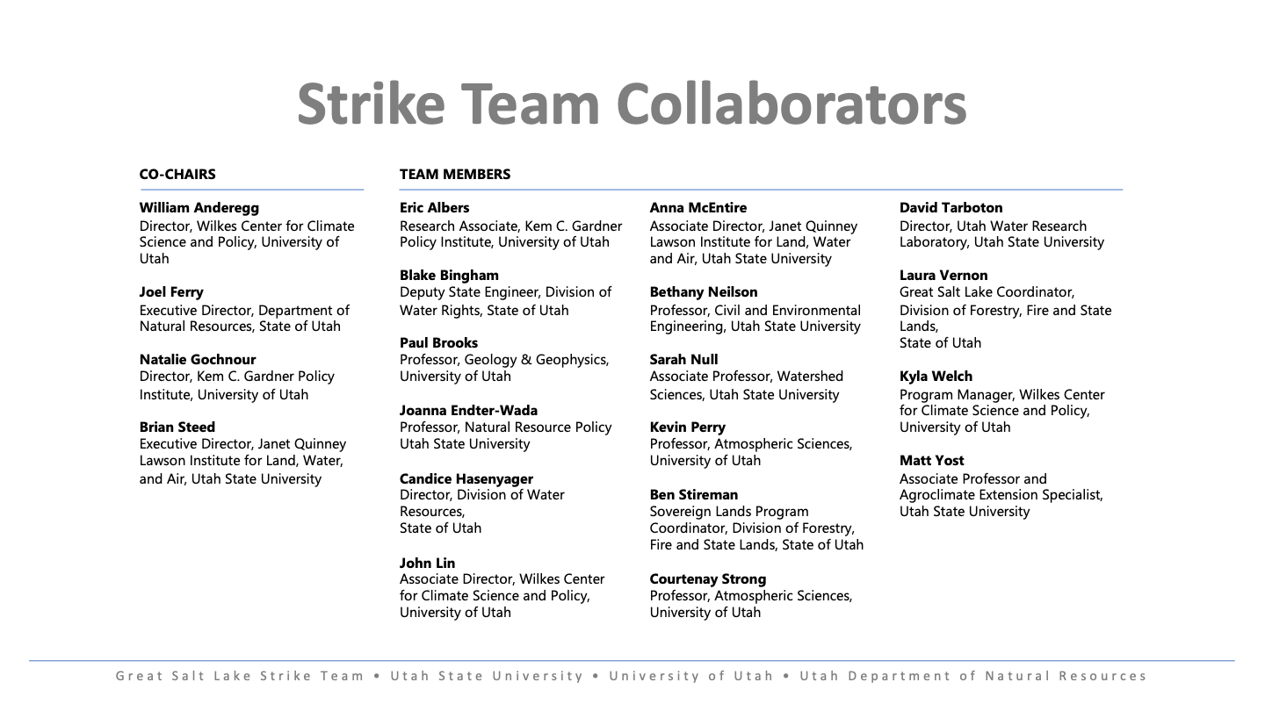

Slide 22
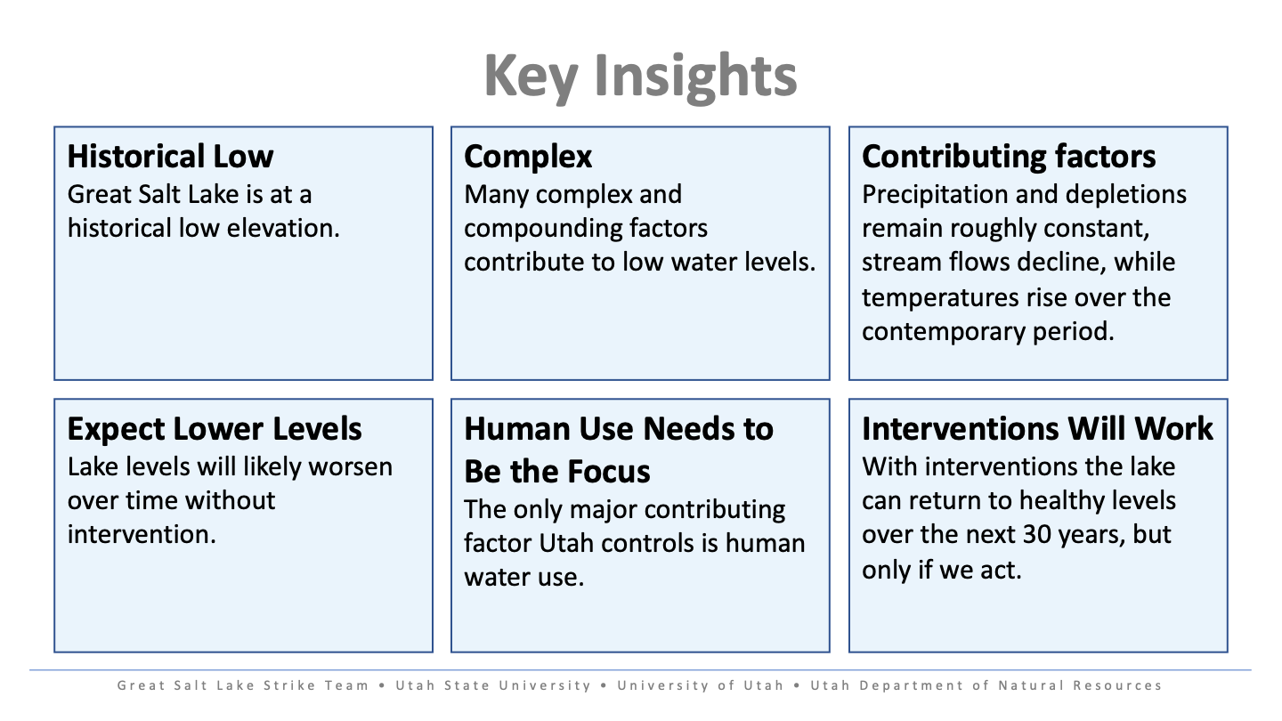

Slide 23
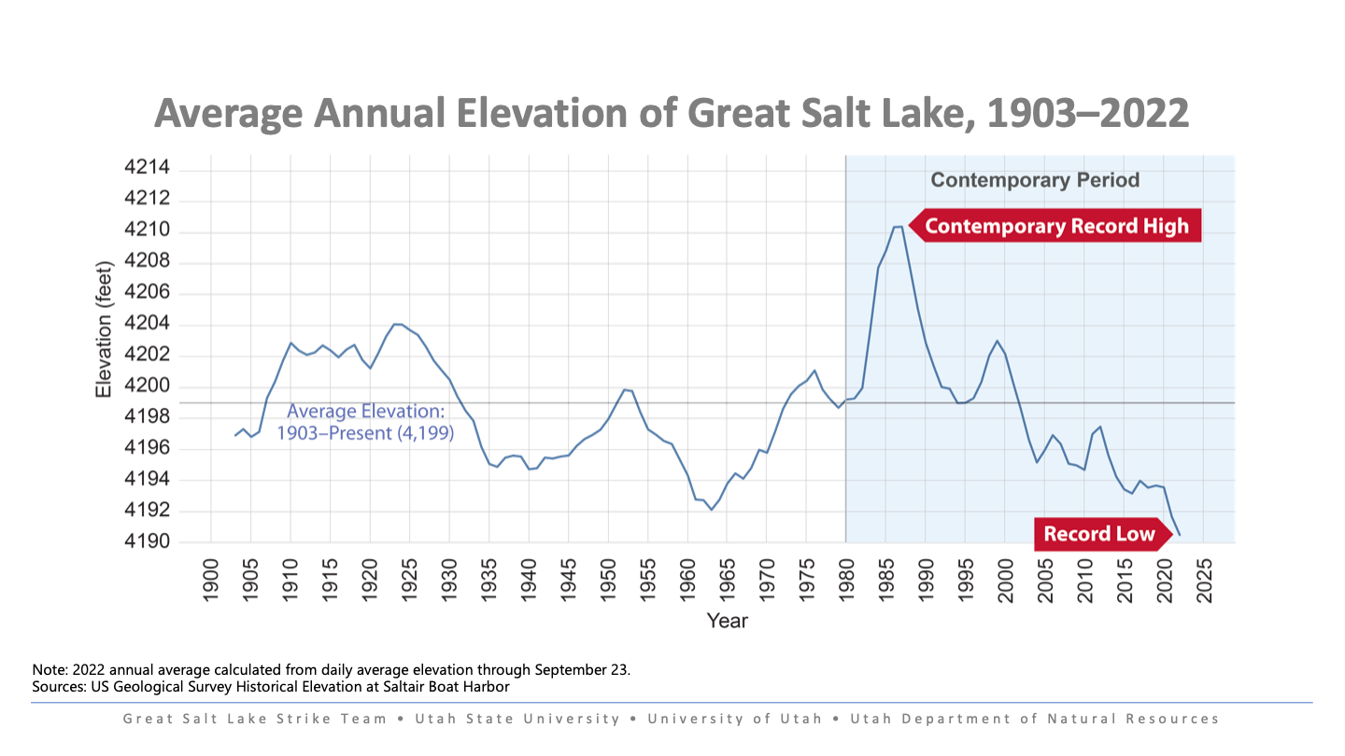

Slide 24
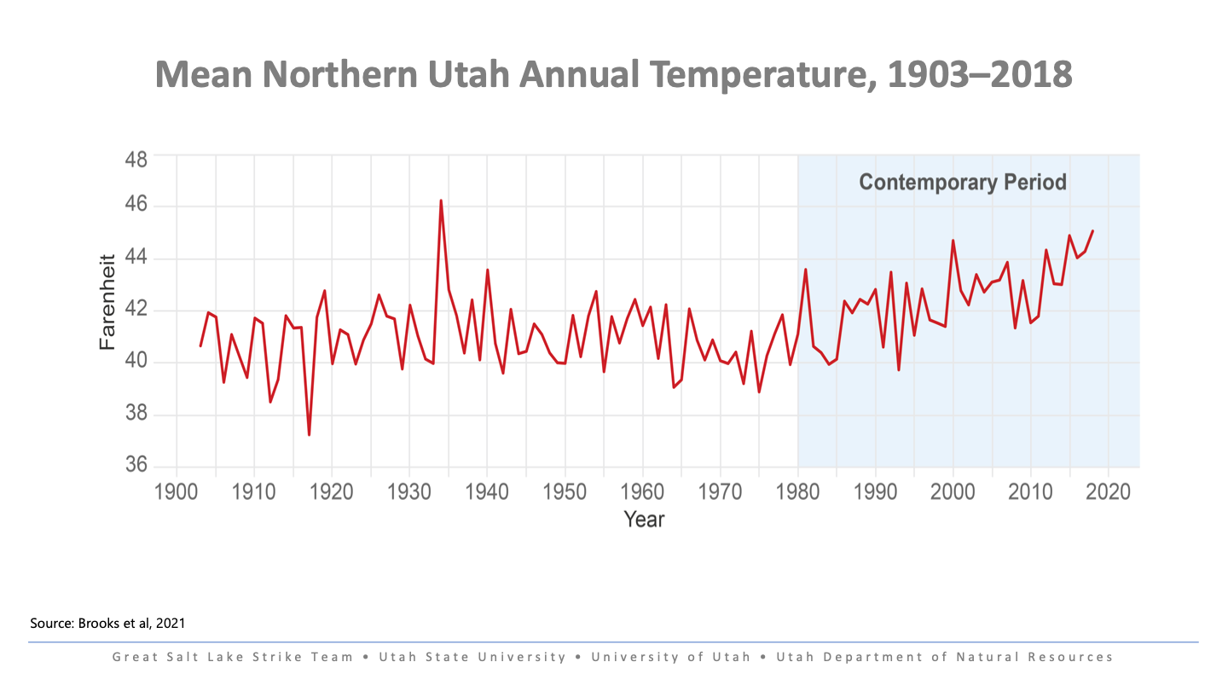

Slide 25
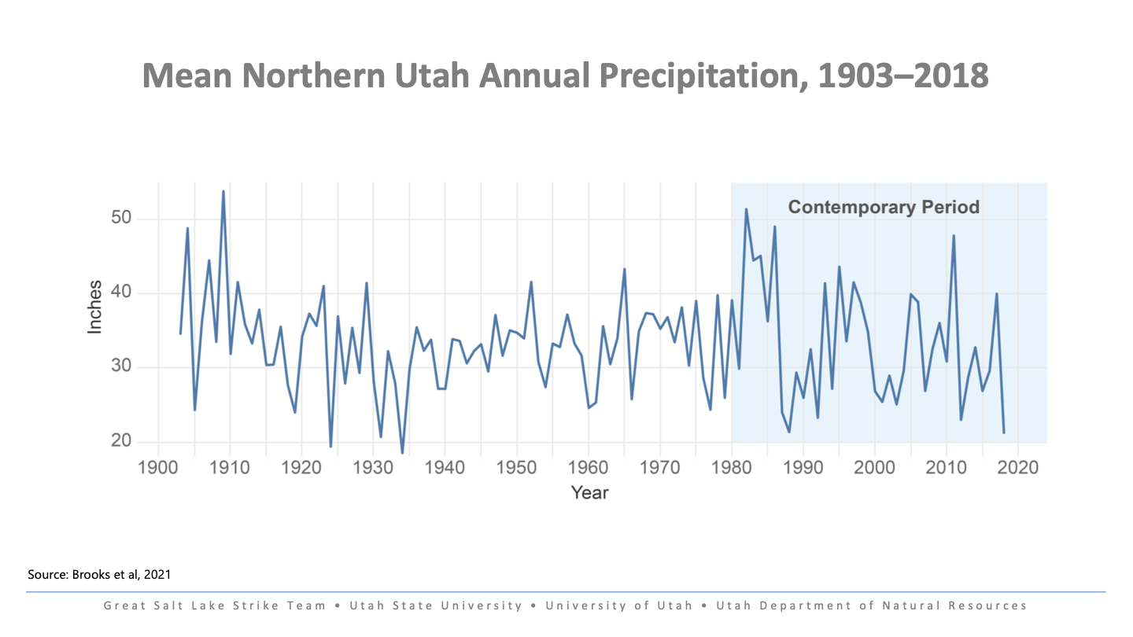

Slide 26
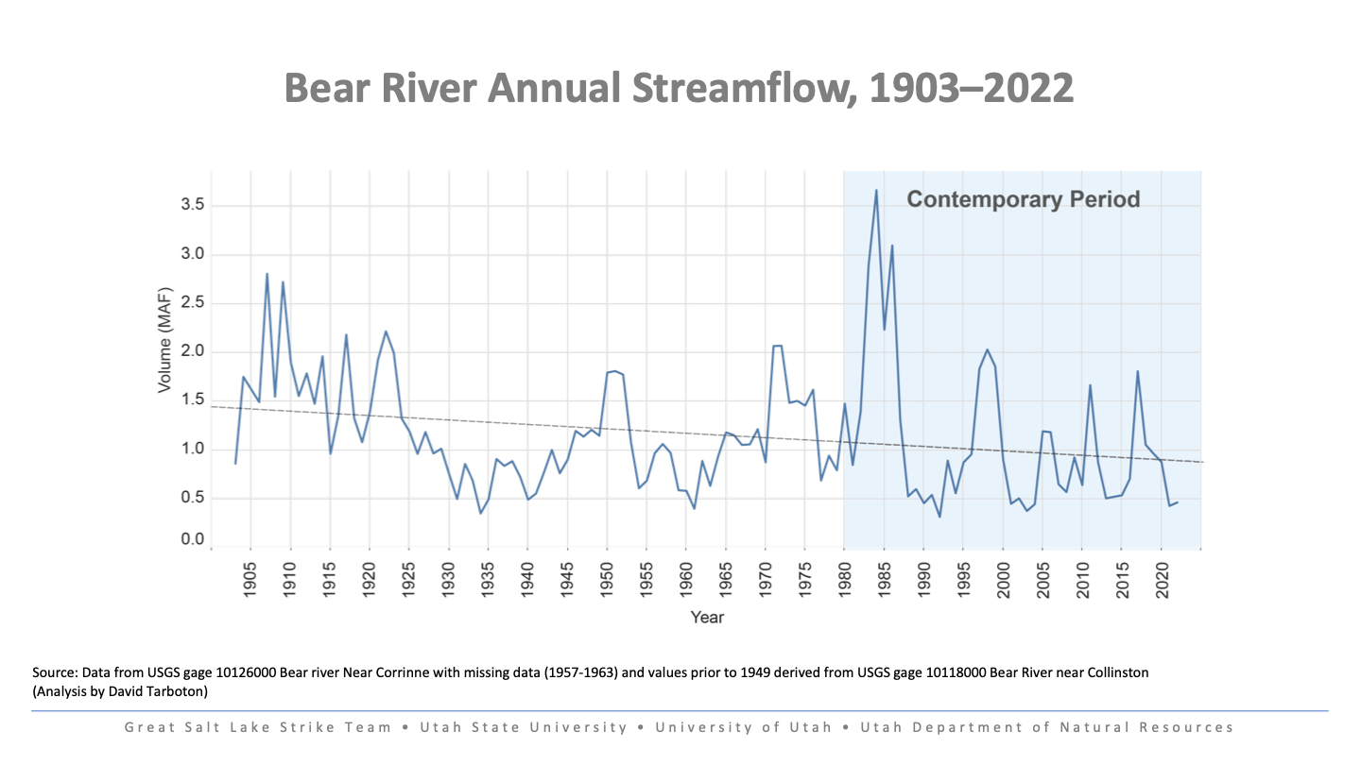

Slide 27
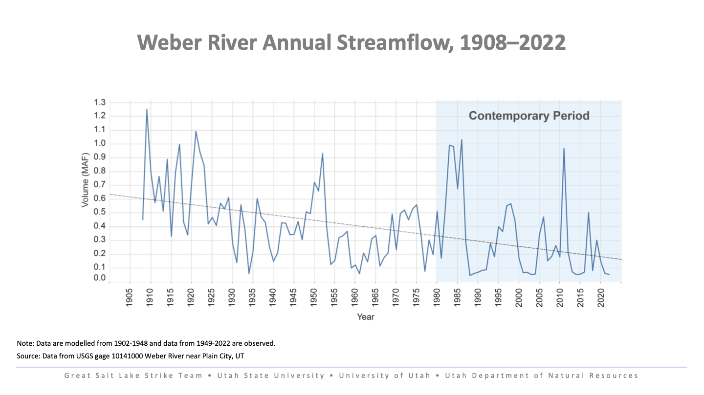

Slide 28
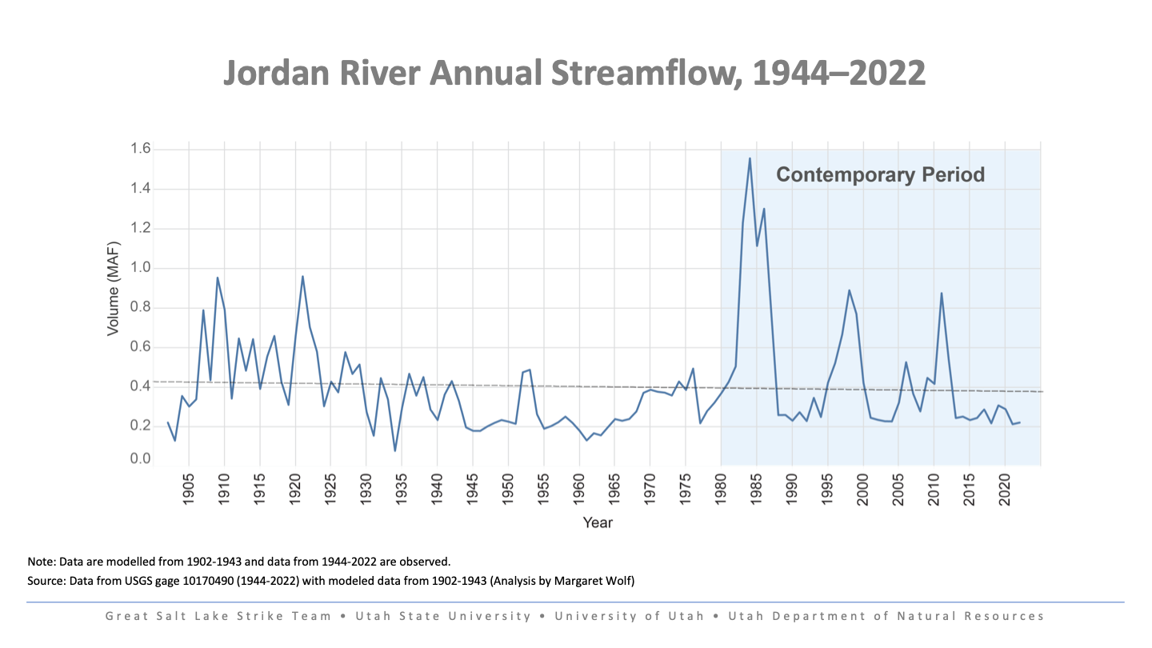

Slide 29
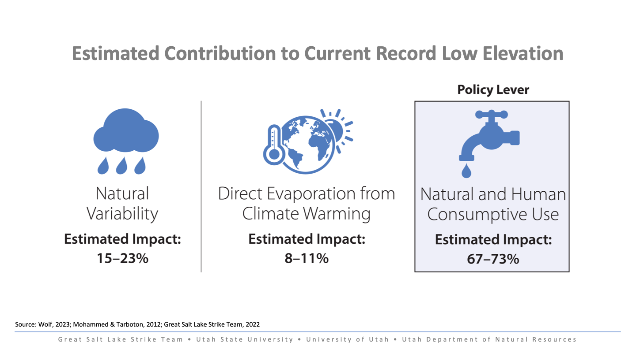

Slide 30
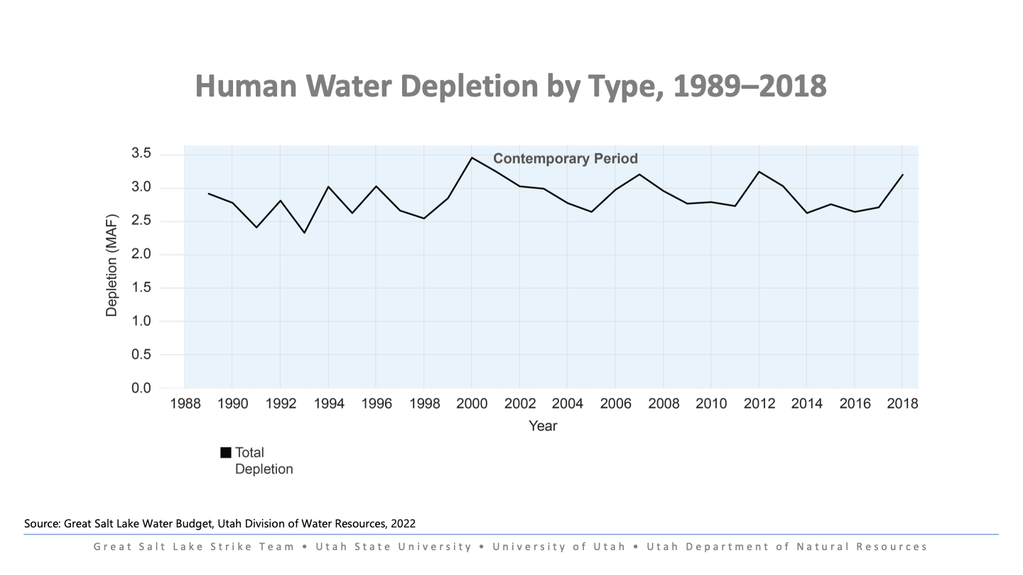

Slide 31
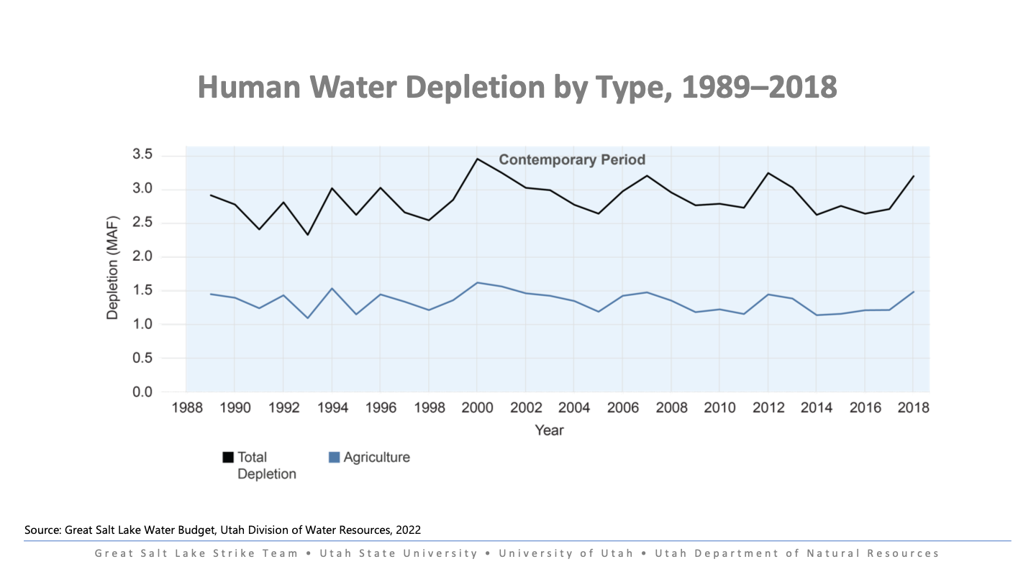

Slide 32
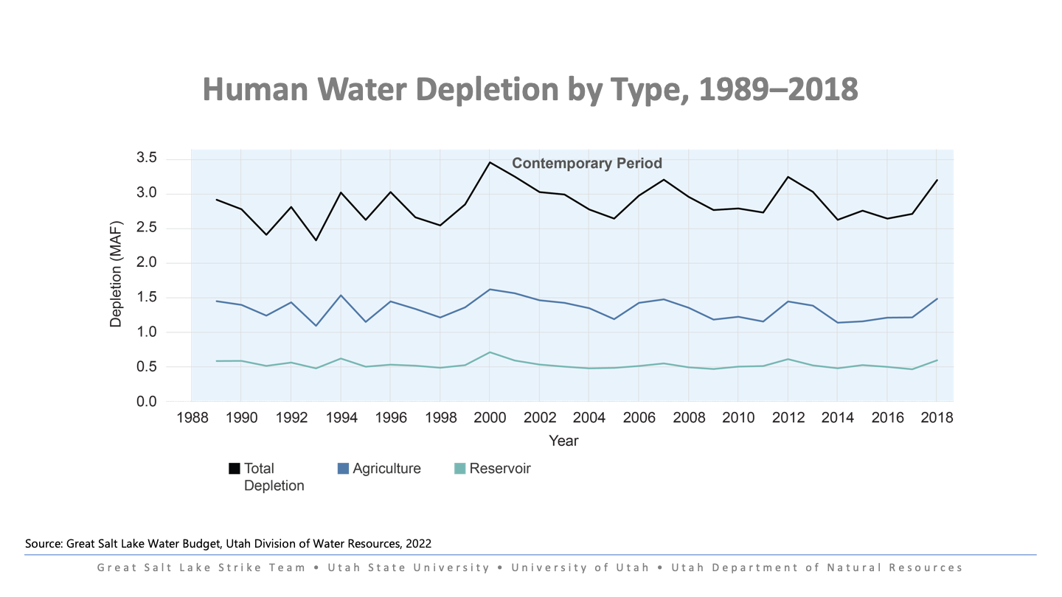

Slide 33
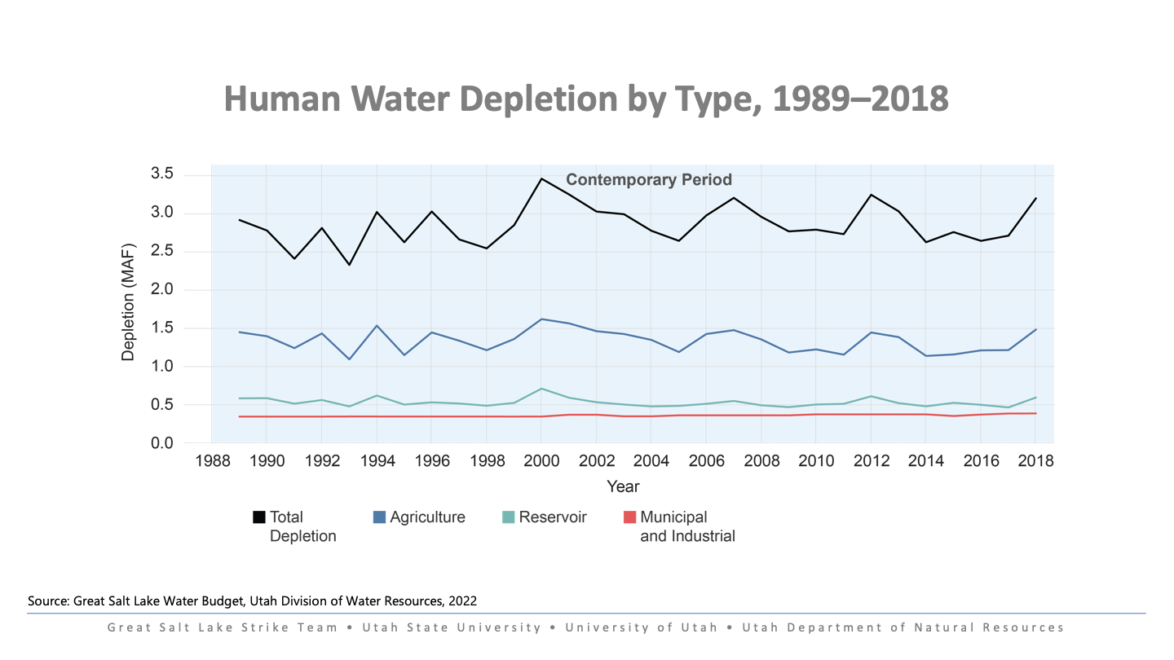

Slide 34
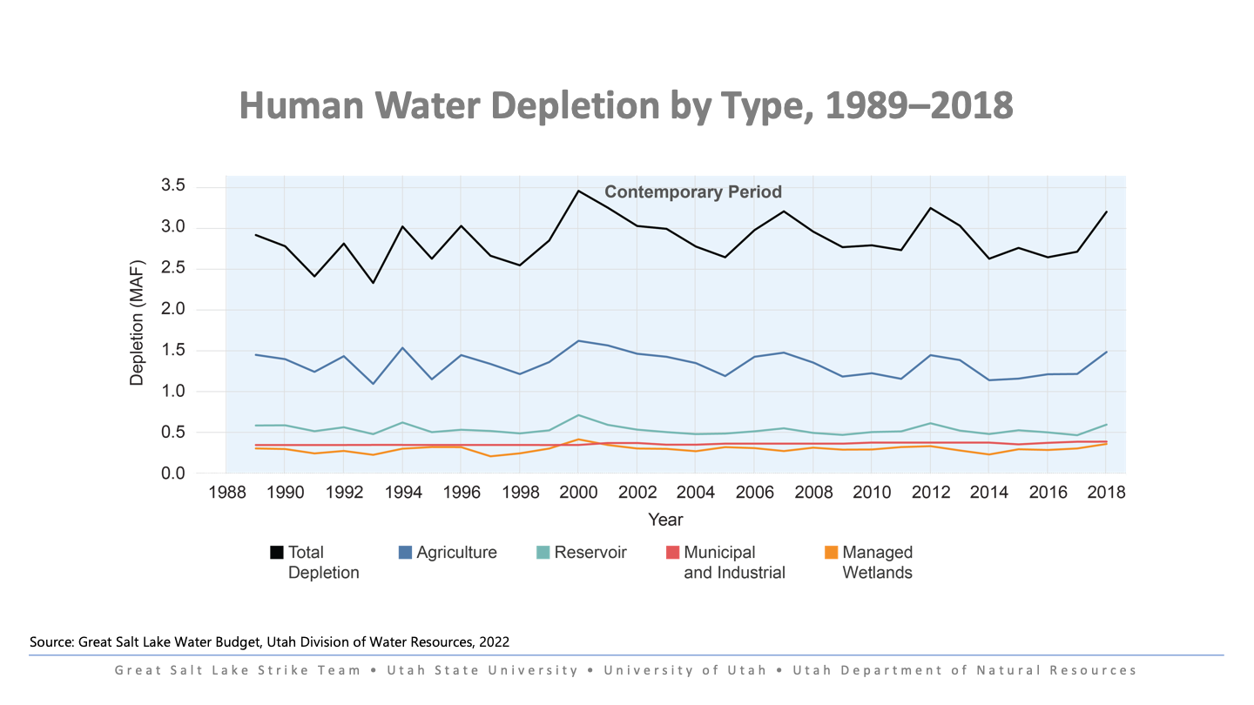

Slide 35
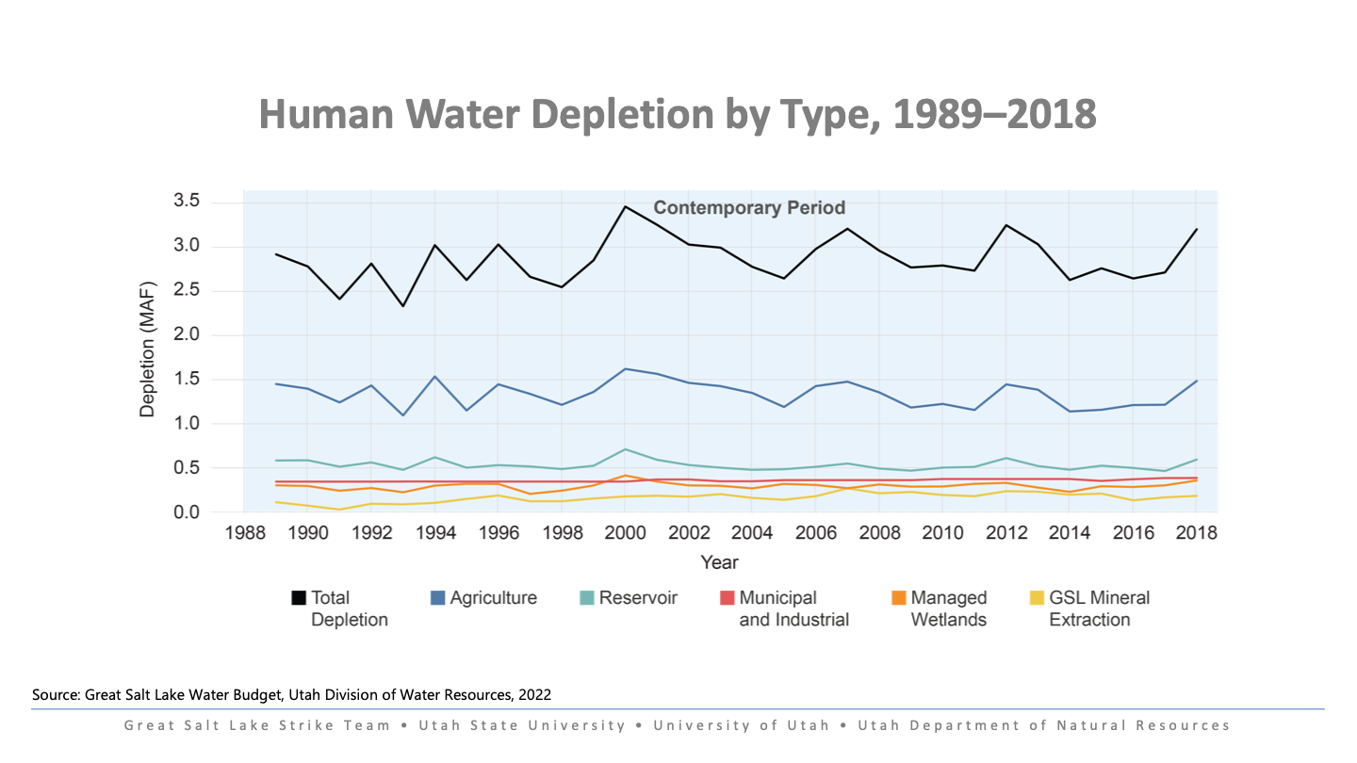

Slide 36
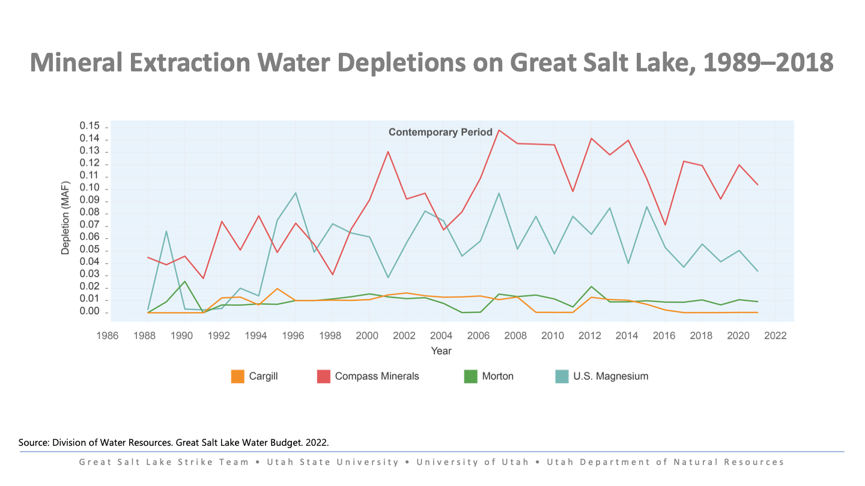

Slide 37
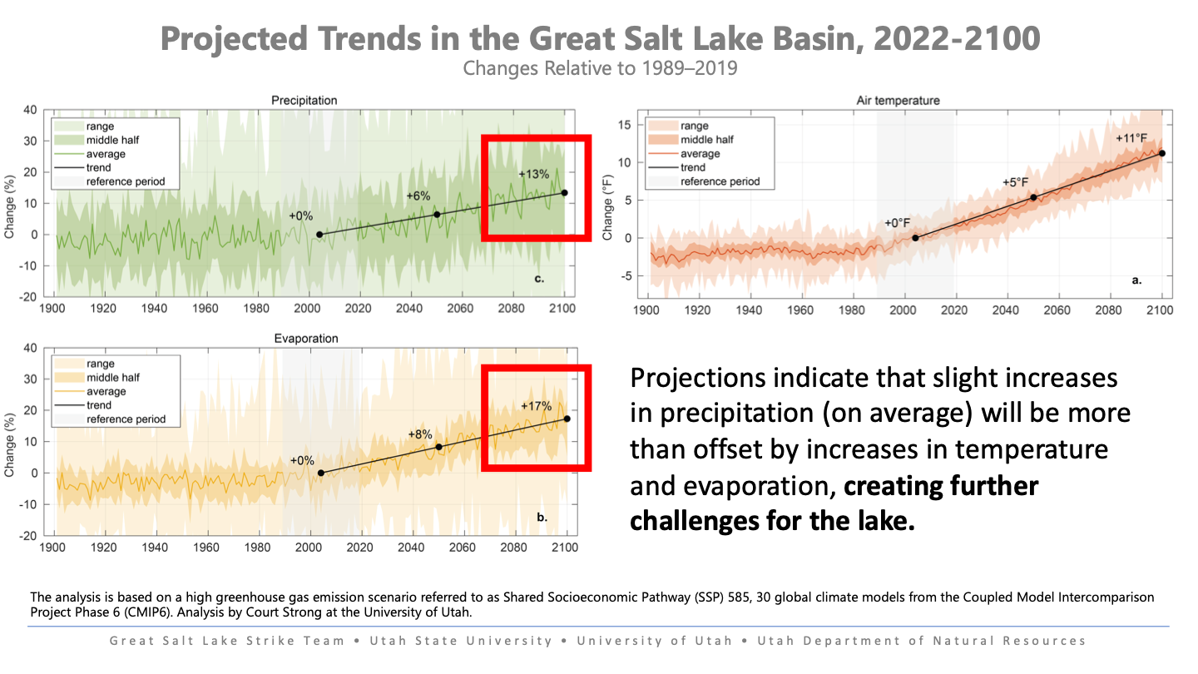

Slide 38
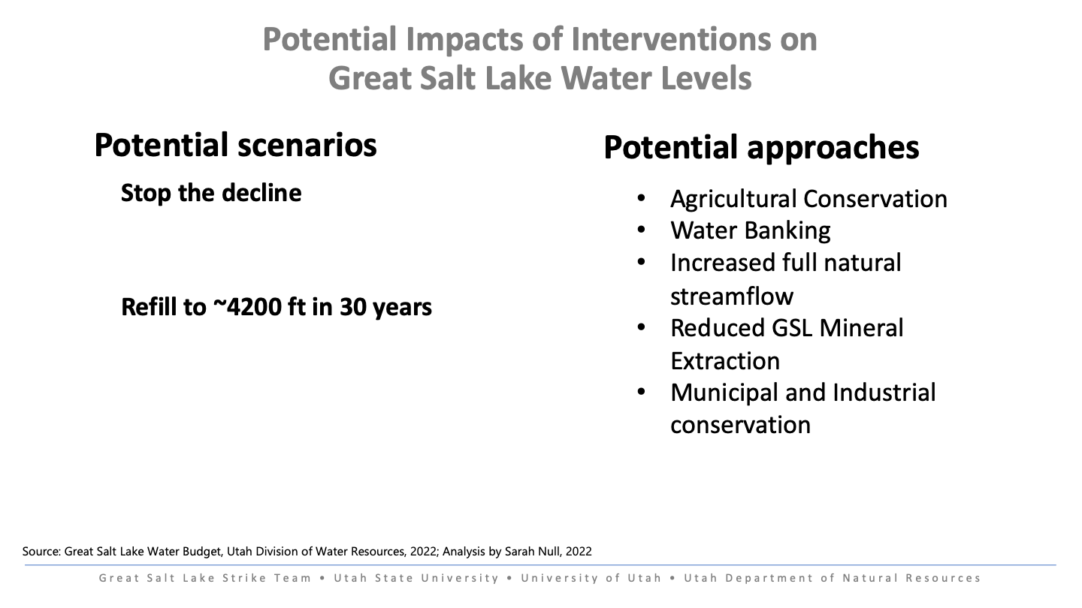

Slide 39


Slide 40

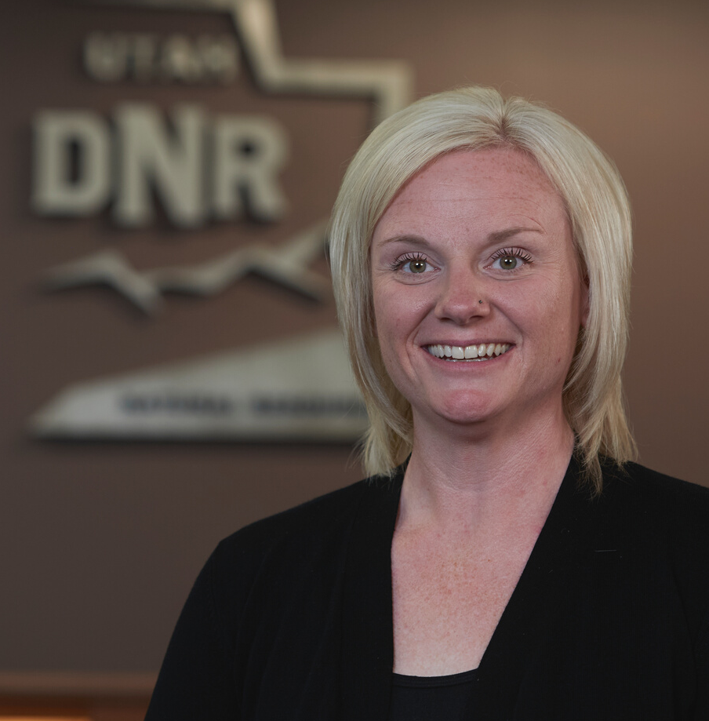
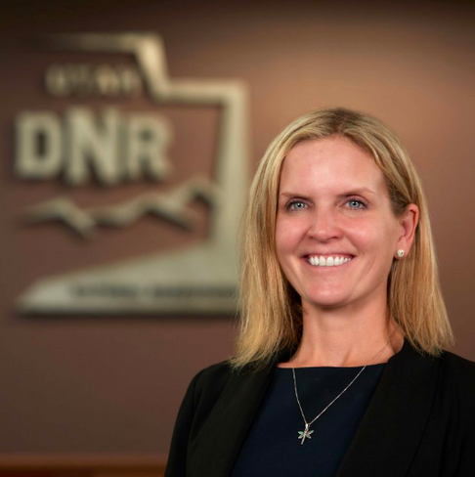
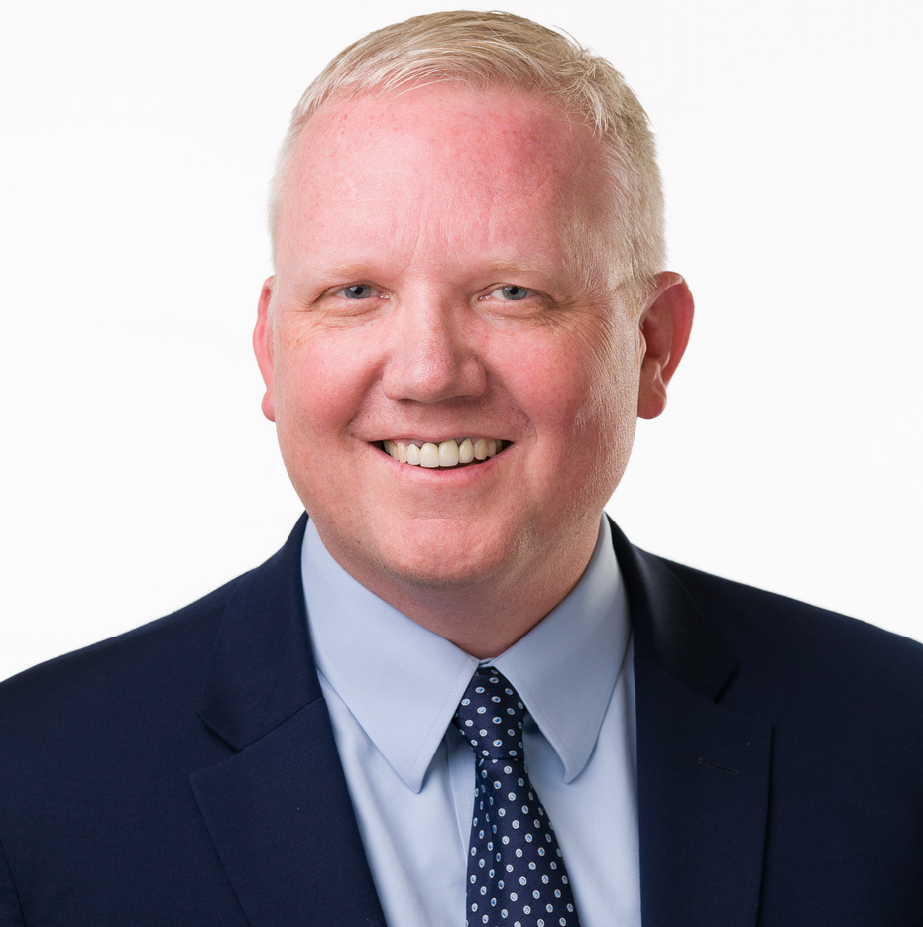
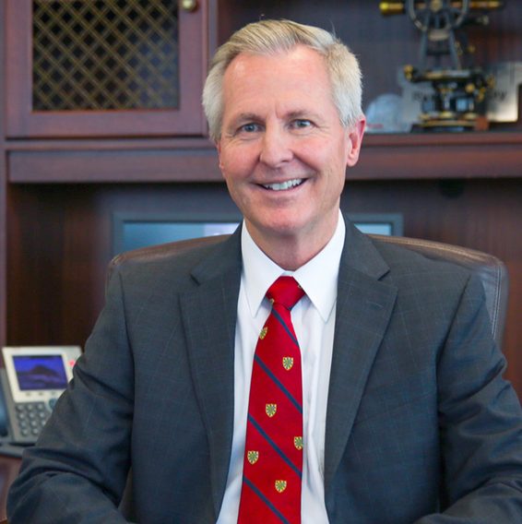
PANEL DISCUSSION:
THE LAKE TODAY
CANDICE HASENYAGER, DWR
BRIAN STEED, USU
JAMIE BARNES, DNR
BART FORSYTH, JVWCD

Slide 41
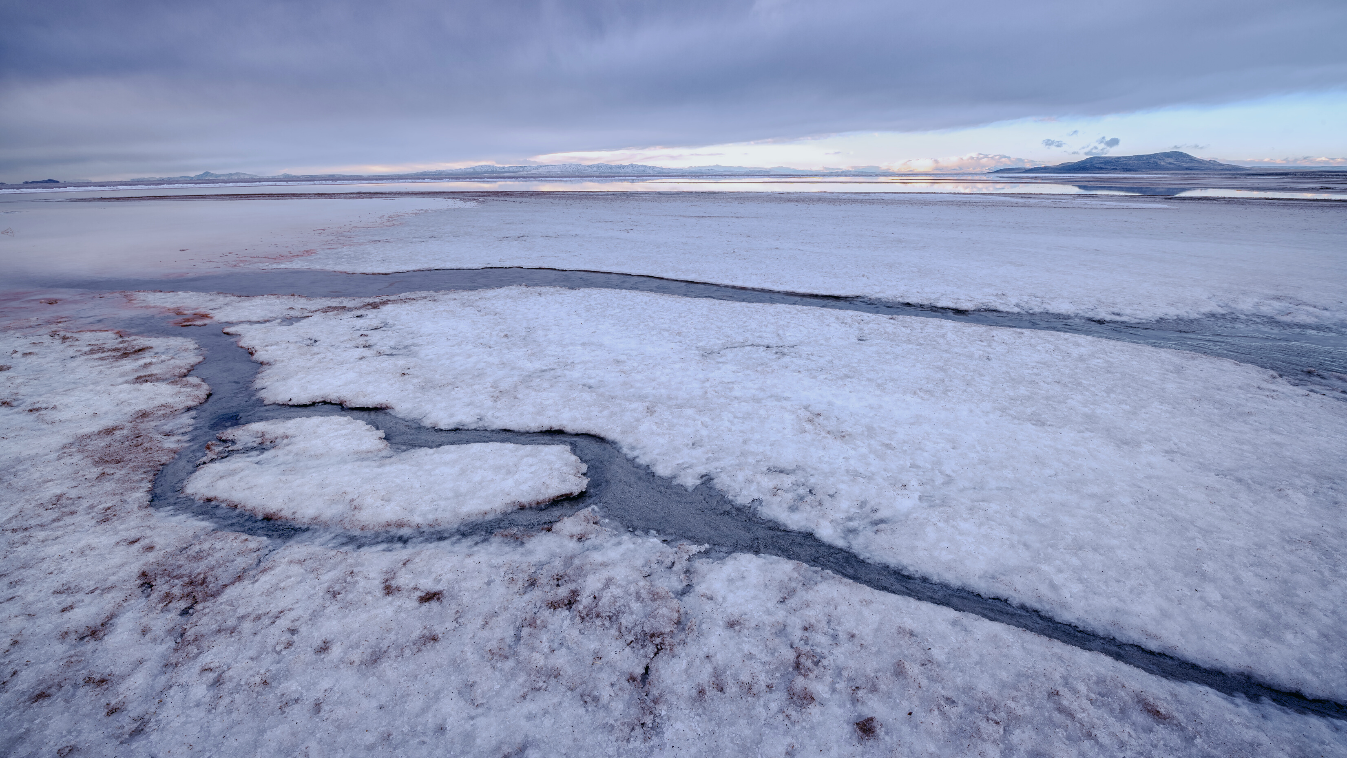
BREAK

Slide 42
GREAT SALT LAKE SUMMIT
SPECIAL THANKS TO OUR SPONSORS!
MEAL SPONSORS:
VIDEO SPONSOR:
TABLE AND EXHIBIT SPONSORS:

Slide 43
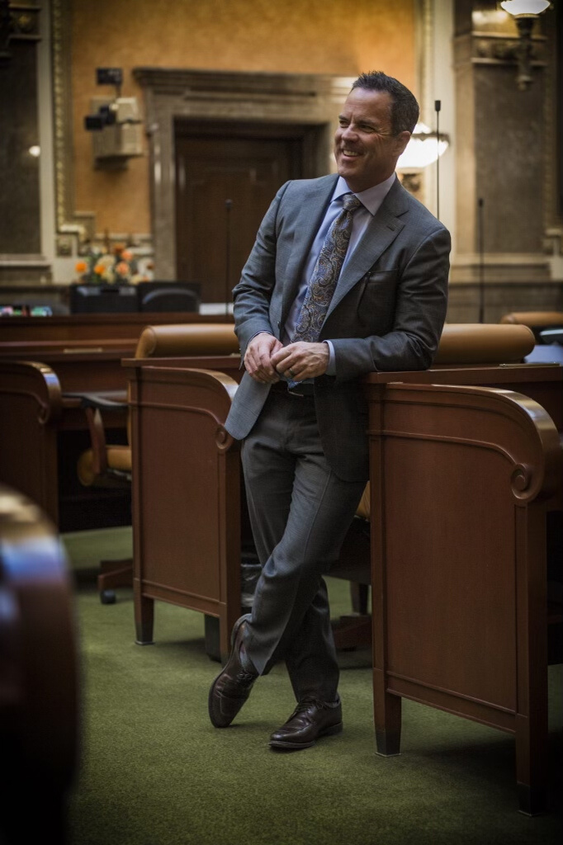
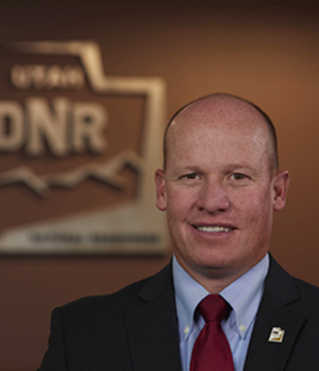
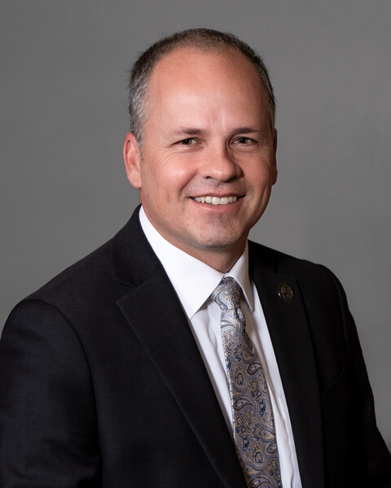
CHALLENGES & SOLUTIONS
FIRESIDE CHAT
SPEAKER WILSON
JOEL FERRY
TIM HAWKES
Utah House of Representatives
Utah Department of Natural Resources
Utah House of Reprentatives

Slide 44

Challenges & Solutions
FIRESIDE CHAT

Slide 45
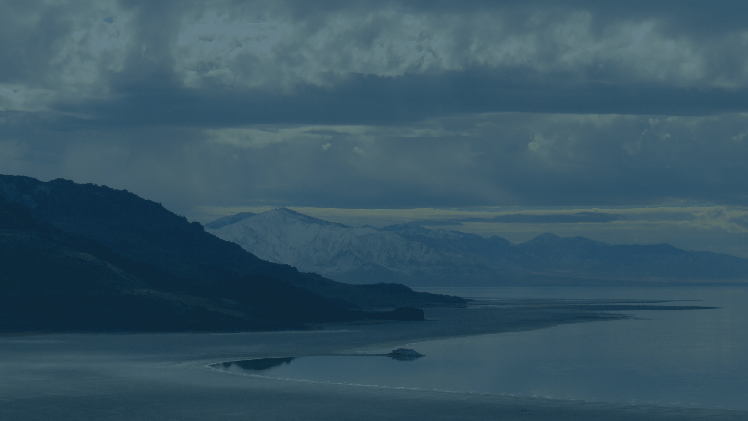
CHALLENGE
Mineral Extraction

Slide 46
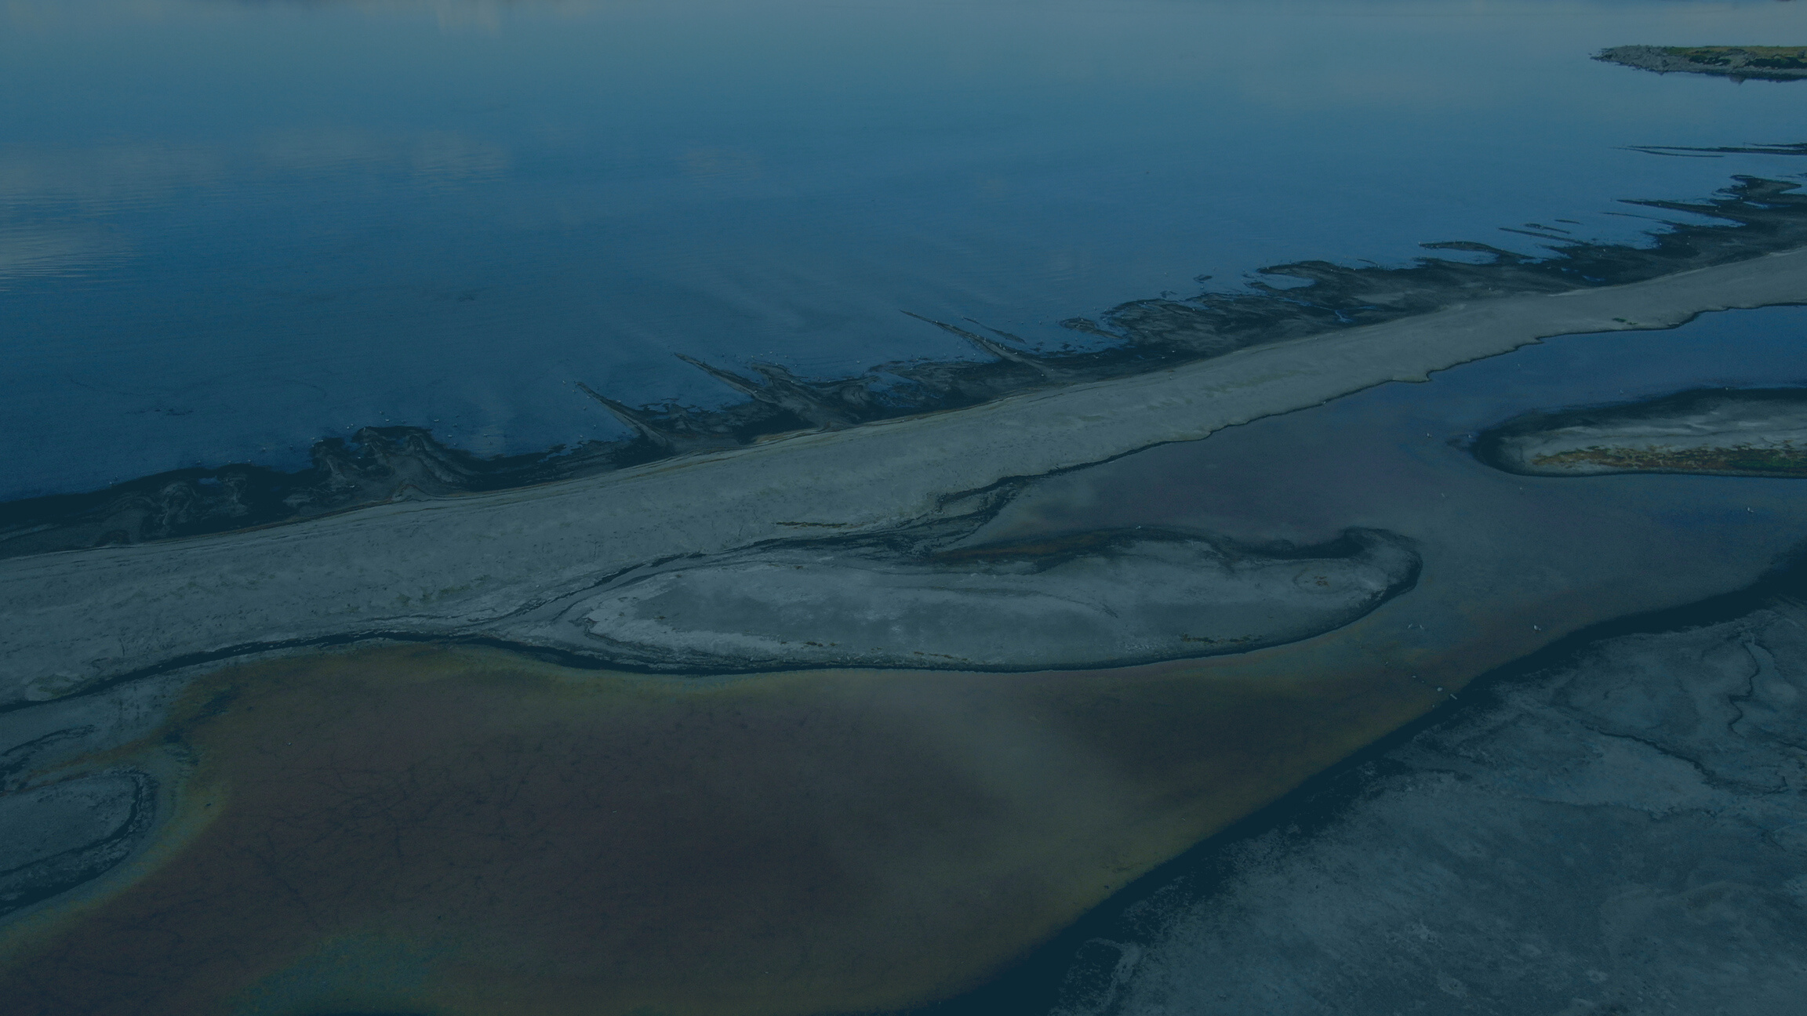
CHALLENGE
Dust Mitigation

Slide 47

SOLUTION
Pipeline from the Pacific

Slide 48

SOLUTION
Cloud Seeding

Slide 49

SOLUTION
Municipal & Industrial Water Use

Slide 50

SOLUTION
Agriculture Optimization

Slide 51

SOLUTION
Leasing Water Rights

Slide 52
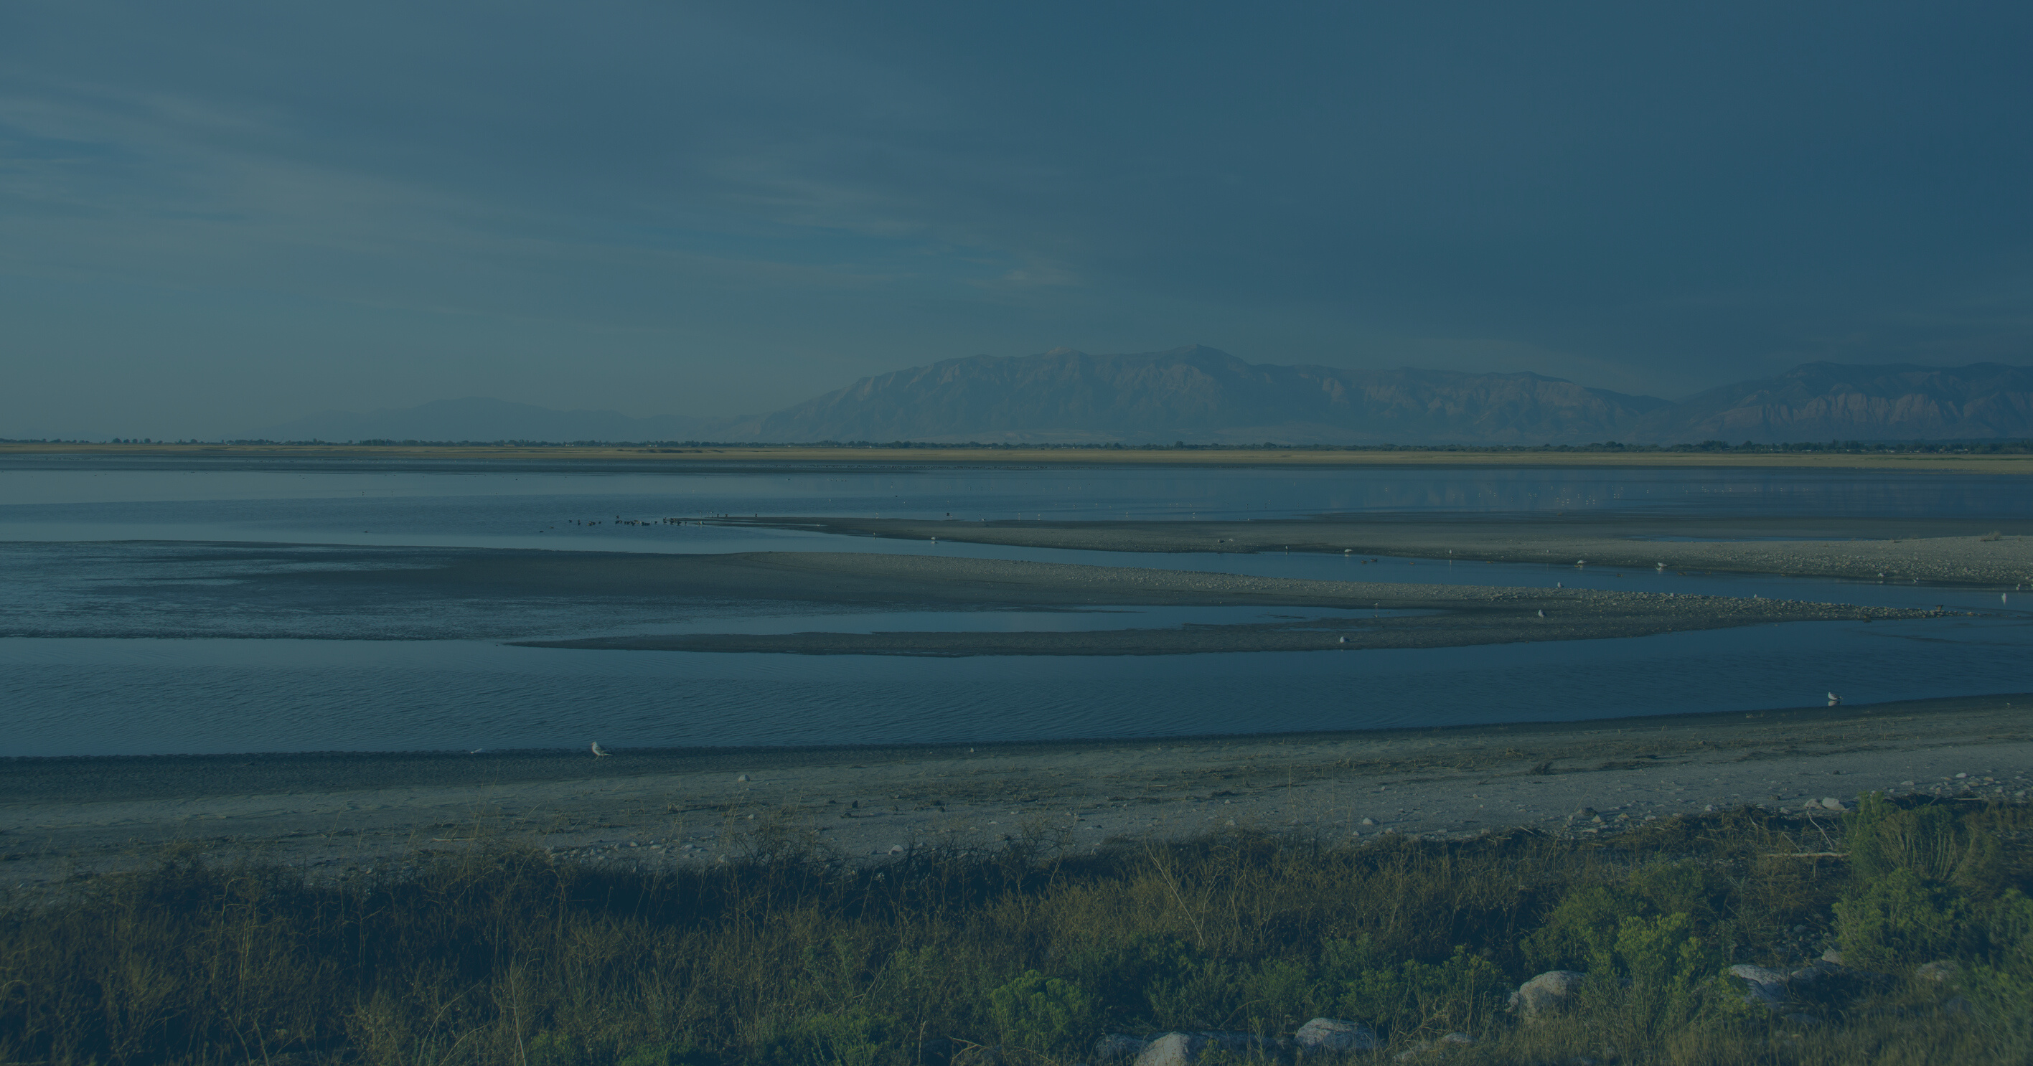
SOLUTION
Ongoing Downstream Efforts

Slide 53
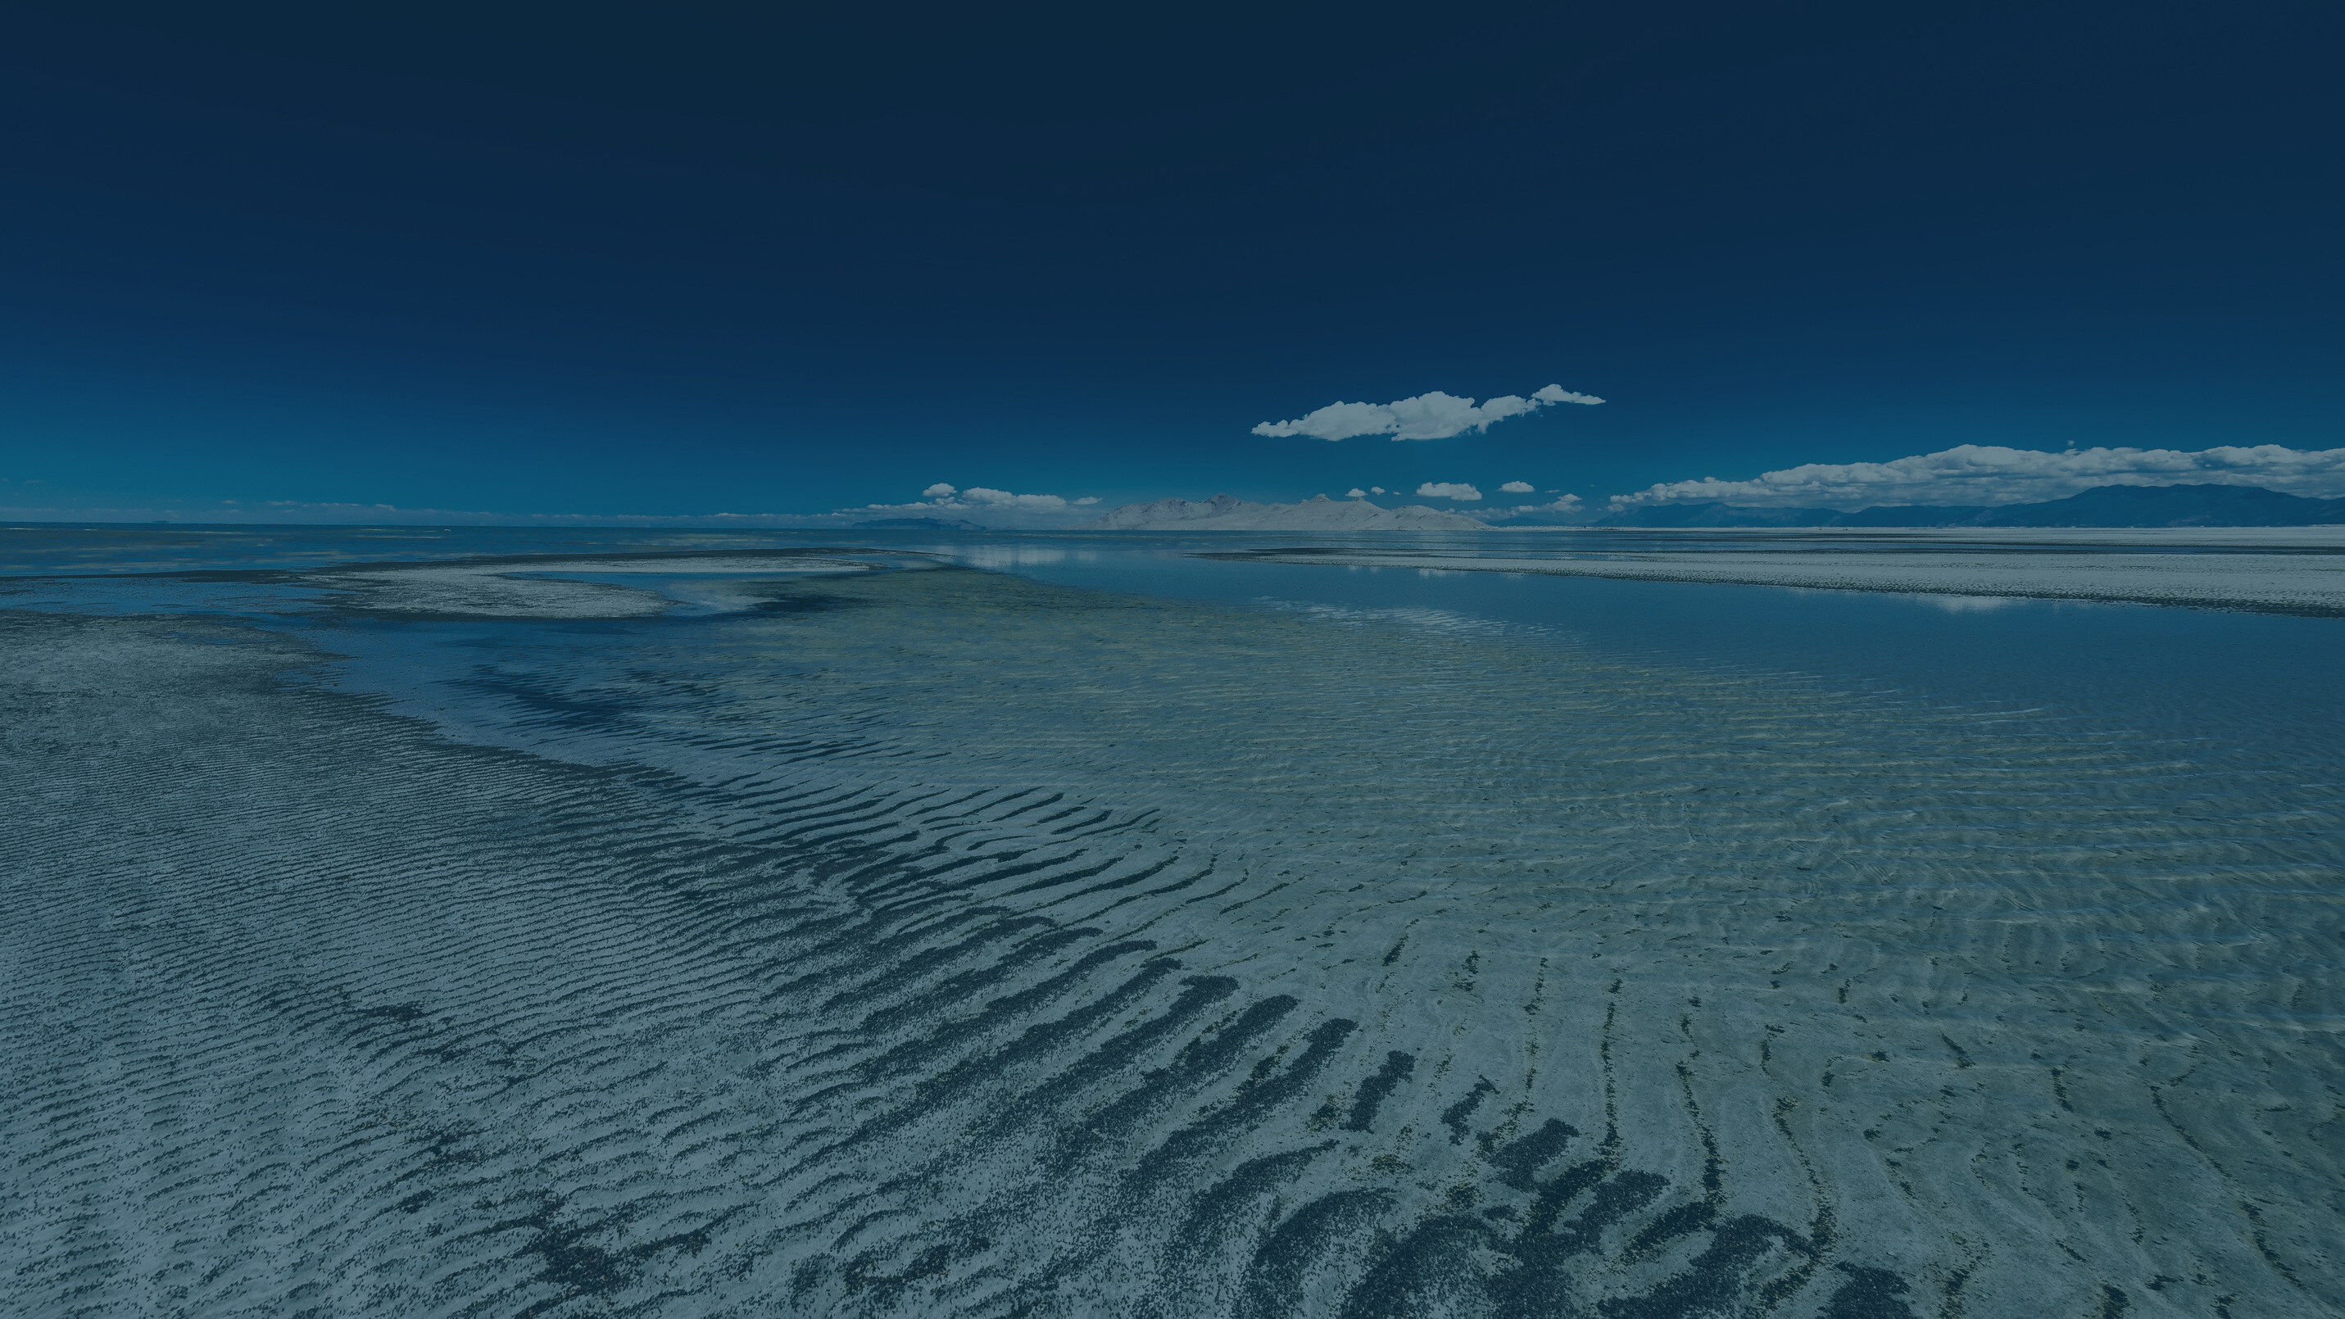
SOLUTION
Federal Funding & National Involvement

Slide 54

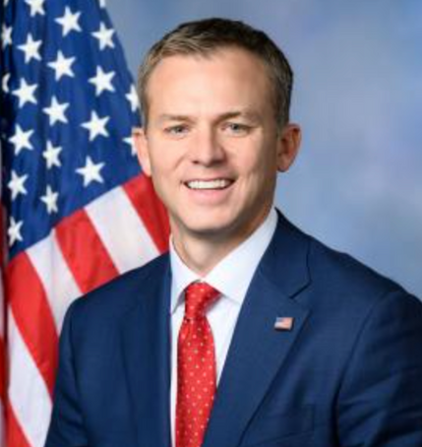


FEDERAL EFFORTS
PANEL DISCUSSION
MODERATOR SPEAKER BRAD WILSON
CONGRESSMAN BLAKE MOORE (UT 1)
SENATOR
MIKE LEE (UT)
SENATOR JOHN BARRASSO (WY)

Slide 55

LUNCH

Slide 56
GREAT SALT LAKE SUMMIT
SPECIAL THANKS TO OUR SPONSORS!
MEAL SPONSORS:
VIDEO SPONSOR:
TABLE AND EXHIBIT SPONSORS:

Slide 57

WHAT'S NEXT?
SPEAKER BRAD WILSON

Slide 58



Slide 59







Slide 61


Slide 62
GREAT SALT LAKE SUMMIT
SPECIAL THANKS TO OUR SPONSORS!
MEAL SPONSORS:
VIDEO SPONSOR:
TABLE AND EXHIBIT SPONSORS:

