Slide 1
November 20, 2019

Slide 2
Let’s start with the “Why?”
Notes:
You all know that income tax is earmarked for education in the Utah Constitution – only state in the nation.
The constitutional earmark on income tax limits the state’s ability to fund the public’s needs, including education. Education funding loses ground during recessions, as the income tax is unstable and volatile.
According to our fiscal analysts – there is only a 30% correlation between the income tax and education funding.
We never dreamed we’d be having this conversation a year ago, but with tax reform and the process of traveling the state and listening to constituents, it was overwhelming that they wanted us to look into this as a possible solution.
It opened a door to a conversation with education stakeholders about how we would go about fundamentally changing the way education was funded in the state.

Slide 3
Guiding Principles
Provide more stability in funding for education.
Develop a more flexible funding system at both the state and local levels.
Further long-held principles of supporting funding equity for students.
Increase overall funding for the system.
Notes:
This proposal is reflective of our guiding principles as we looked to stabilize, enhance, and equalize Utah’s public education funding.

Slide 4
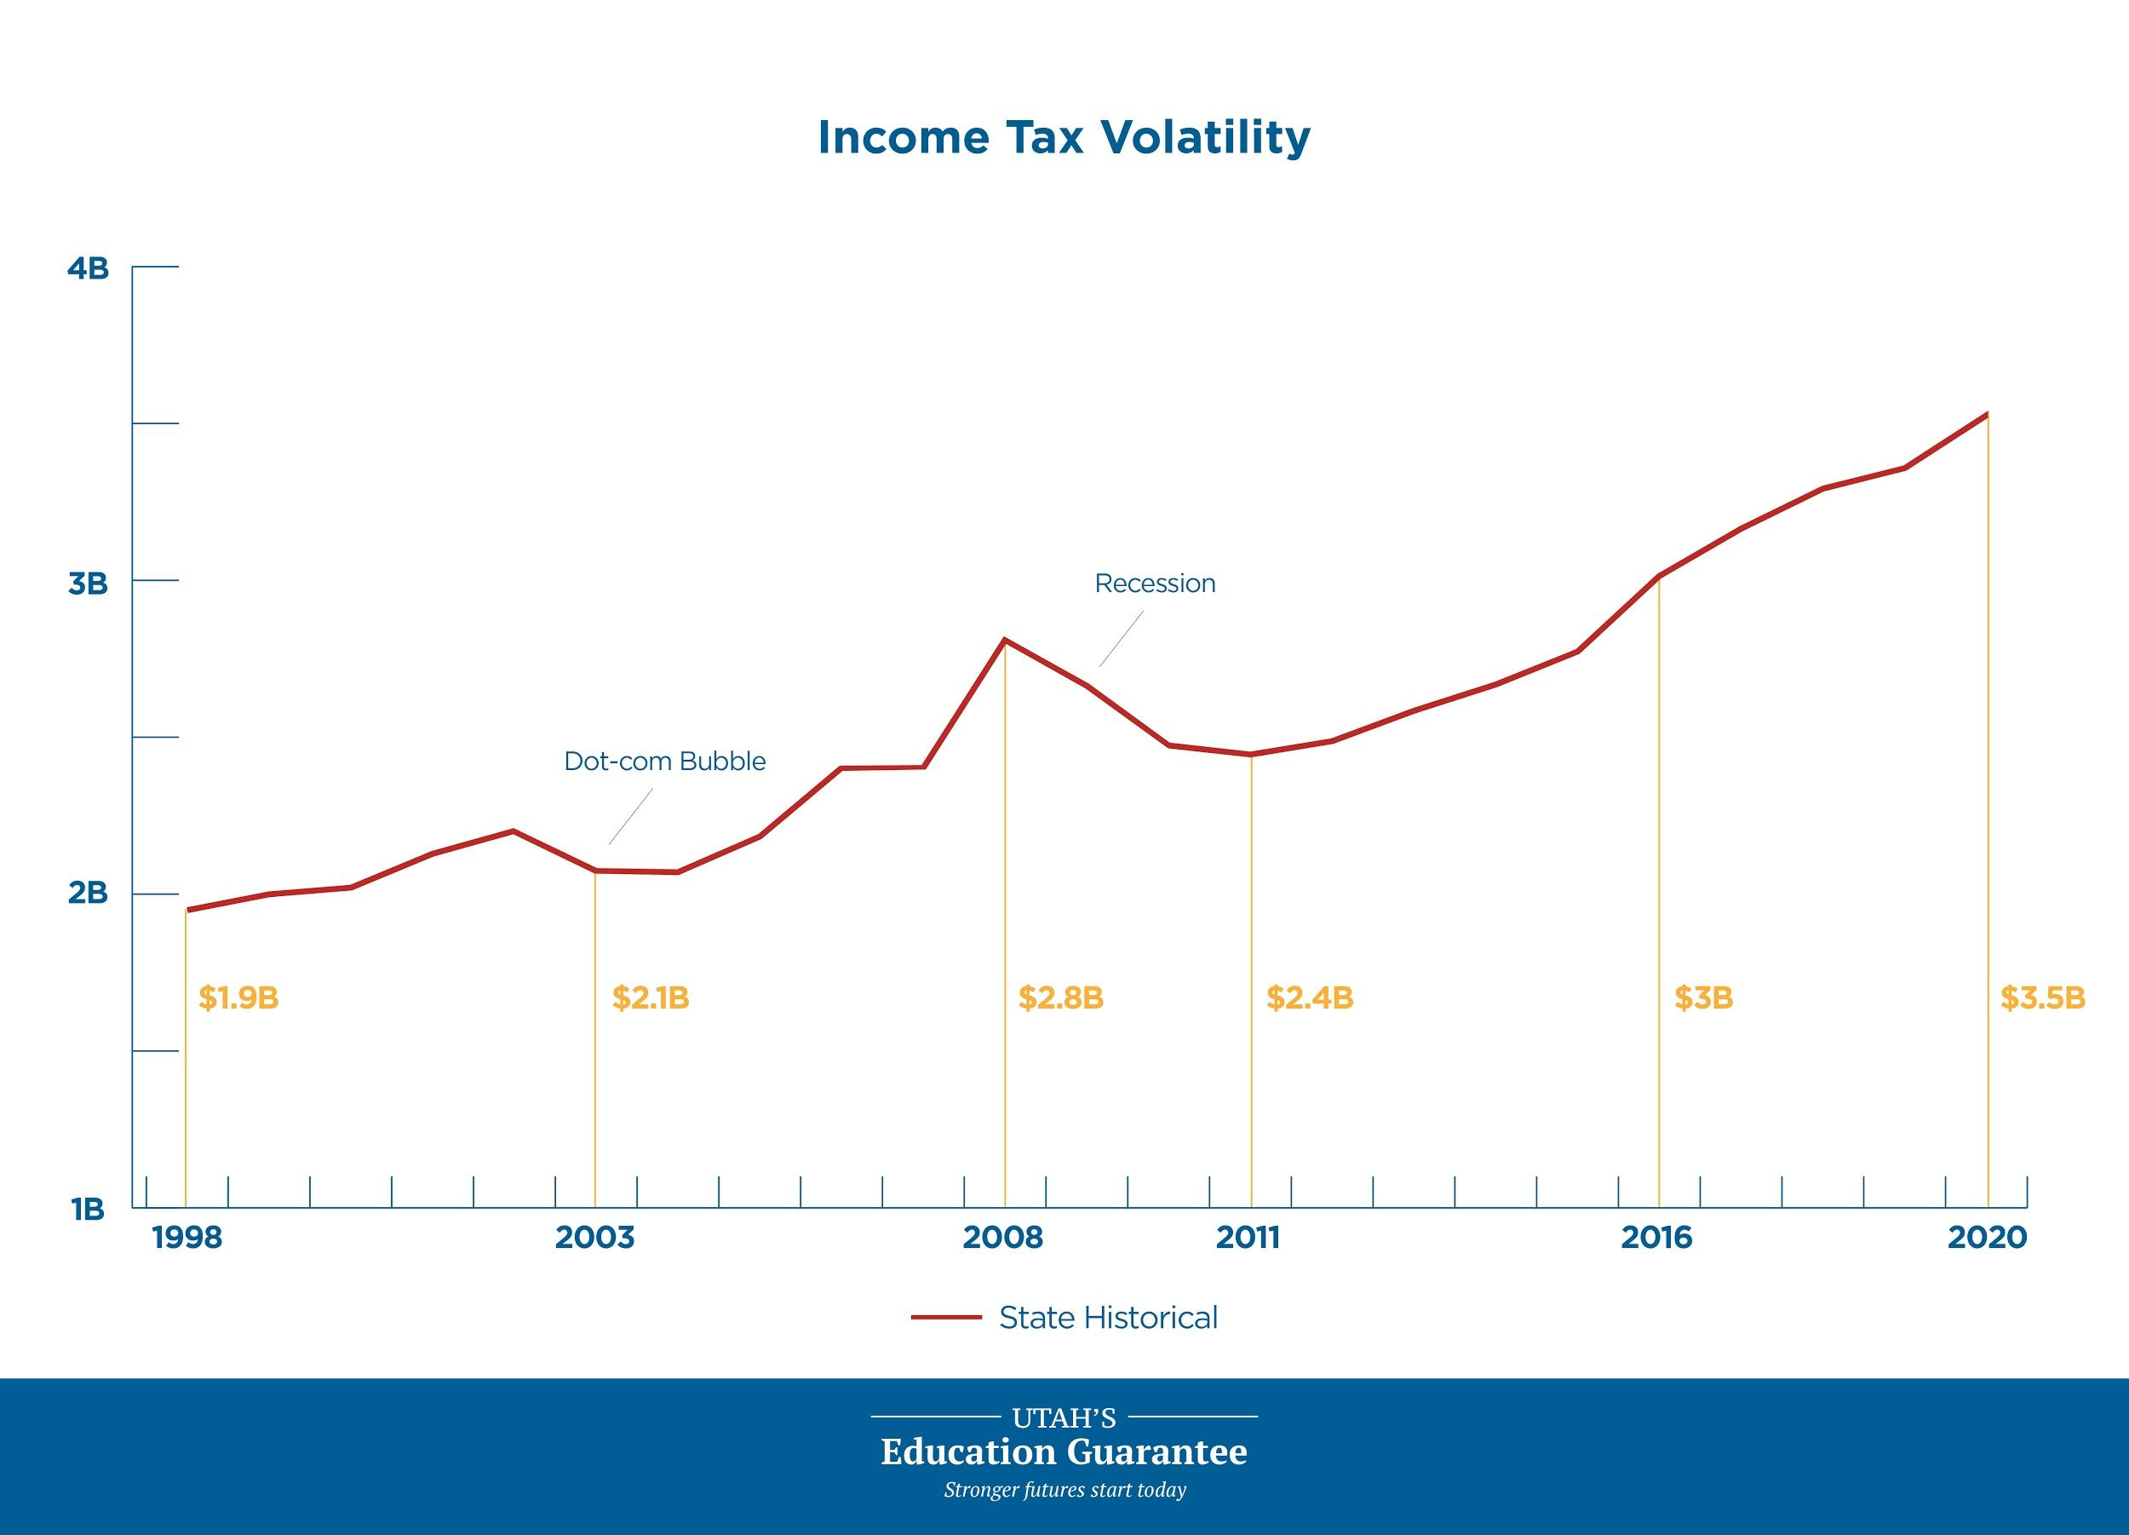
Notes:
Now let’s move into some of the data and technical side of the proposal.
As can be seen in this graph, income tax is a very volatile form of revenue. Since 1998, there have been years when the state has funded public education at a higher rate, and years where state funding is lower. Usually, this coincides with the economy. This is good when the economy is thriving, but when it is not and income tax revenue is low, the state must reconcile the difference.
We are hoping to replace this current funding mechanism with a stable form of revenue for public education funding.

Slide 5
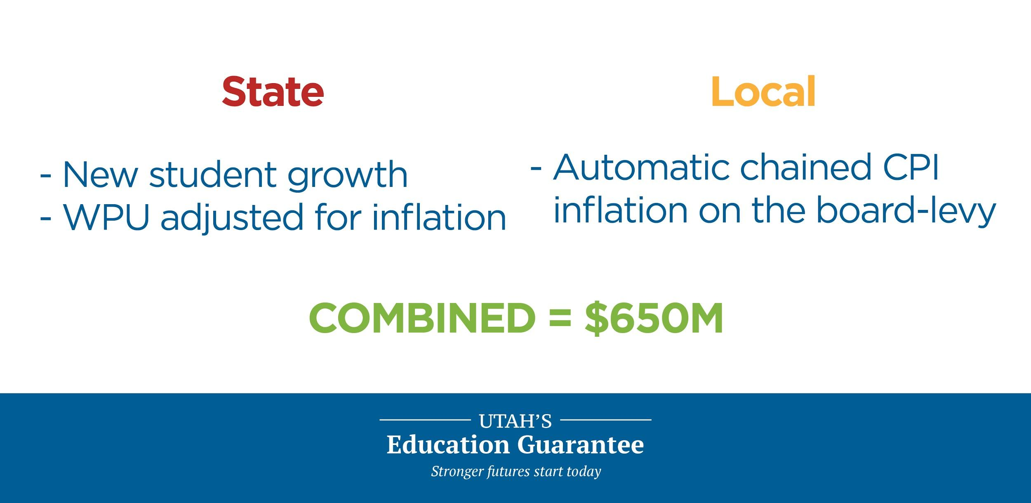
Proposal
Notes:
Per state statute, the state and local governments have a shared responsibility for public education funding. This proposal will change the way we fund education on both the state and local levels.

Slide 6
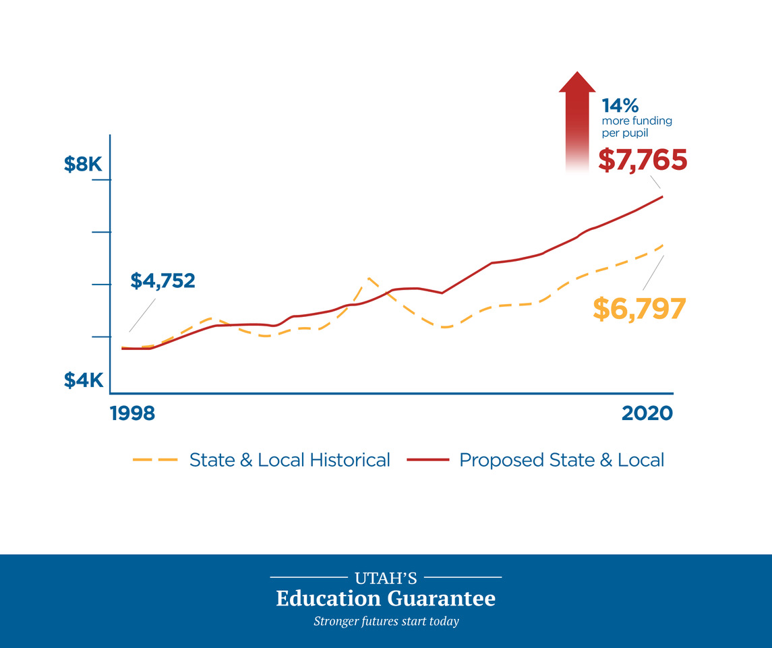
Notes:
This graphic illustrates the difference in funding using our current funding structure and comparing that to if this would have been enacted in 1998.
You see, we would have seen 14% more funding per pupil this year.
The best decisions are ones that take the long-view approach. We will not see drastic changes in education funding immediately, but this is a marathon, not a sprint.

Slide 7
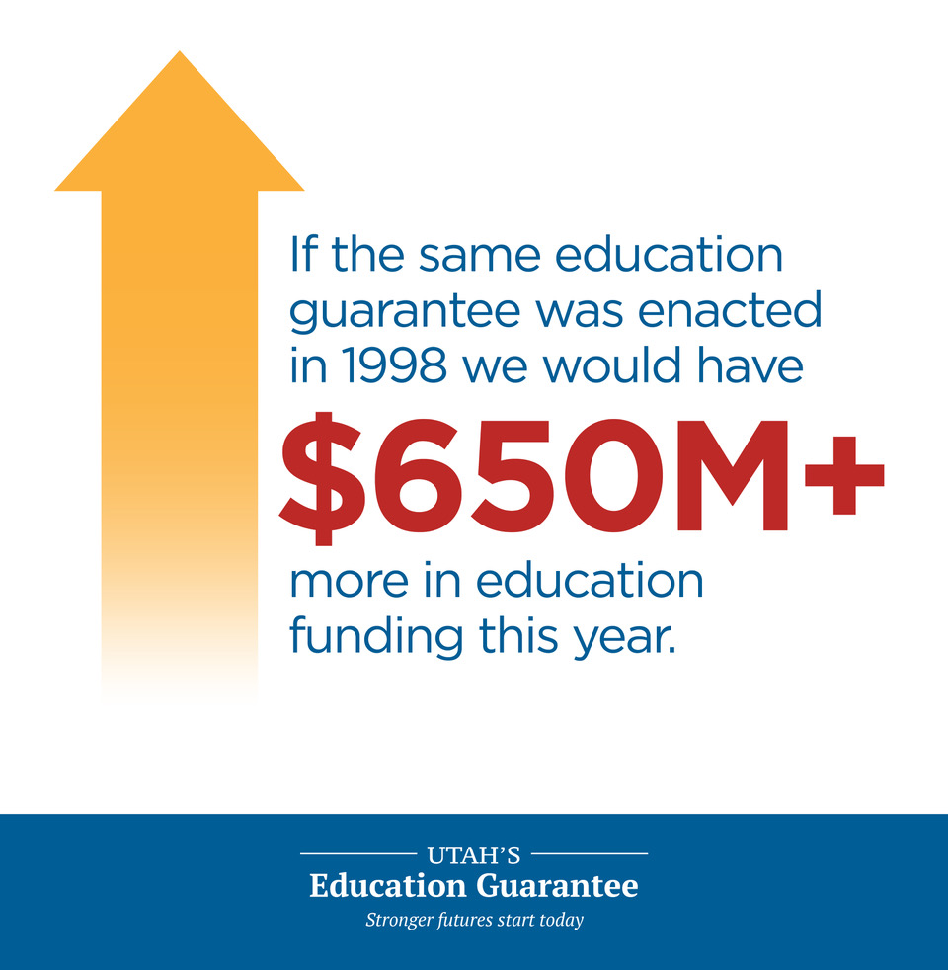
Notes:
Once again, if implemented in 1998, Utah would have a total of $650 M more in education funding this year alone. Can you imagine the total additional funding education would have received year after year?
We need to think of our children, our grandchildren, and the many generations yet to come.

Slide 8
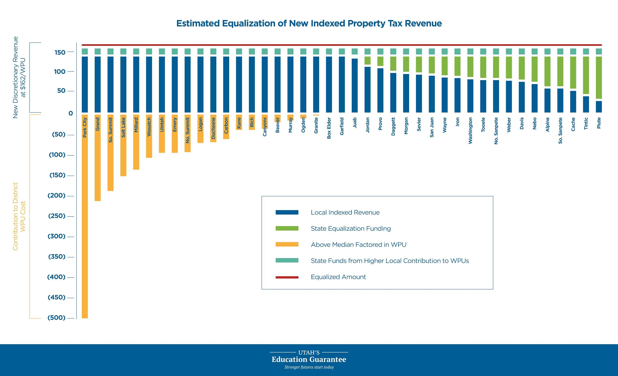
Notes:
The Utah Education Guarantee increases funding potential at both state and local levels.
All school districts will benefit from an inflationary adjustment on their property tax revenue.
School districts with per-student revenue from the inflationary adjustment that do not meet the median of all districts will receive state funding so that students in all Utah school districts have the opportunity for the same high standard of education.
In simpler terms, all school districts will receive at least the median amount per weighted pupil unit from the inflationary adjustment.

Slide 9
Local Property Taxes
Voted, board, and capital property tax revenue will be indexed for inflation using a chained CPI (estimated at 1.83%).
This will exempt inflation adjustments from statutory Truth-in-Taxation requirements.
Property taxes are a much more stable revenue source, compared to the volatile income tax revenues.
We will be placing guardrails around the growth factor to ensure property tax rates to not exceed certain levels.
Notes:
Voted, board, and capital property tax revenue will be indexed for inflation using a chained CPI (estimated at 1.83%).
This will exempt inflation adjustments from statutory Truth-in-Taxation requirements.
Property taxes are a much more stable revenue source, compared to the volatile income tax revenues.
We will be placing guardrails around the growth factor to ensure property tax rates to not exceed certain levels.

Slide 10
Slow and Sustainable
Average home price in Utah is around $300,000.
Year 1 = $10 increase in property taxes
Year 5 = $39 increase in property taxes
Notes:
The average home would see an increase of approximately $10 on property taxes in year 1 under this new proposal. In five years, that same household would see an increase of about $39.
The growth is slow and sustainable, unlike the extreme property tax hikes we have seen throughout the state.

Slide 11
Constitutional Guarantee
Notes:
The Utah Education Guarantee will put in place a more stable funding structure for education.
The legislature must pass this proposal by a majority vote.
Additionally, if the legislature decides to replace the constitutional earmark with a more secure and less-volatile funding mechanism, it must receive ⅔ vote in both the House and the Senate.
If passed by the House and Senate, the replacement would be placed on the ballot in November 2020 and left in the hands of voters to approve.

Slide 12
Will outcomes change?
Notes:
That is certainly our hope, but we as the legislature can’t make change alone.
We need a solid working partnership with the districts and teachers.
What this proposal does – it releases the year to year tension that currently exists.
Each year we have education stakeholders rallying for more funding – and they start with the WPU growth and inflation.
We have taken that tension away to begin with with this plan.
We allow the conversation to start around what programs and what needs are there to fill a districts strategic plan.
This is a marathon and not a sprint – we must work together to make this successful – and it starts with this caucus and this body on whether or not you want to take the opportunity to fundamentally change the way we fund education in this state.
We are asking you whether or not we should allow the voters of this state to all the opportunity to move forward.

Slide 13
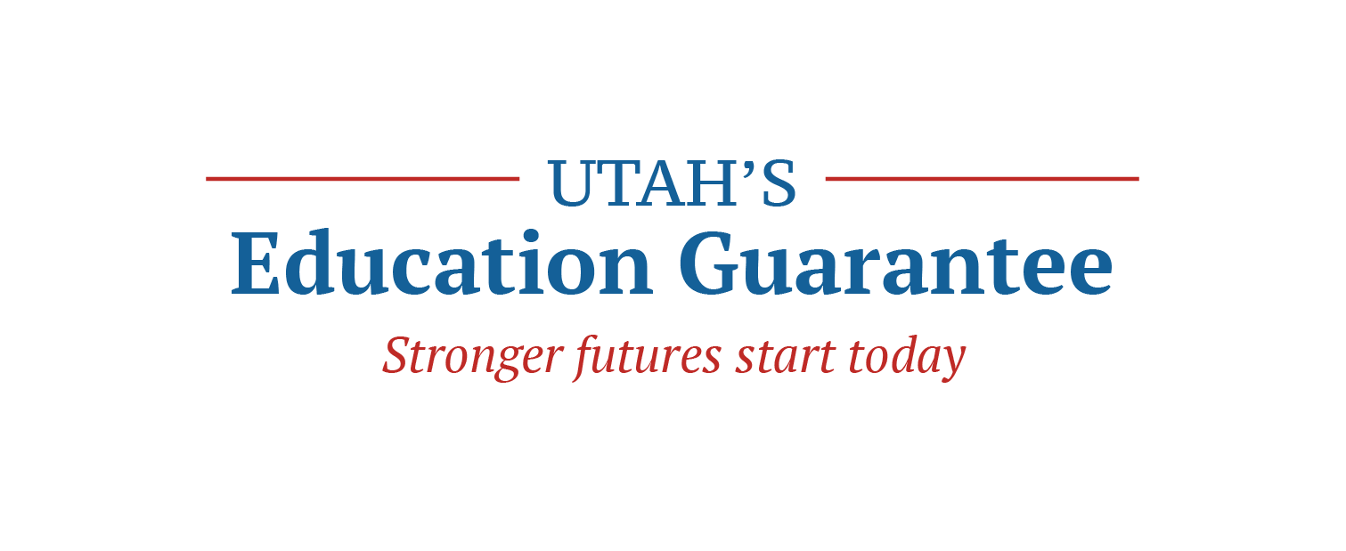
Notes:
This guarantee means a brighter, stronger future for Utah children.
Stronger futures start today - Utah’s Education Guarantee pledges to stabilize, enhance and equalize education funding in Utah.
The guarantee will:
Stabilize education funding sources to provide reliable funding year to year.
Enhance education funding to (1) allow for adjustments for inflation, (2) to accommodate student population growth, and (3) to increase flexibility for teacher salaries.
Equalize education funding statewide so no matter where a child lives, every student is given an equal opportunity to a great education.

