Slide 1
One Option: Reduce Spending
Tax Restructuring and Equalization Task Force
September 5, 2019

Slide 2
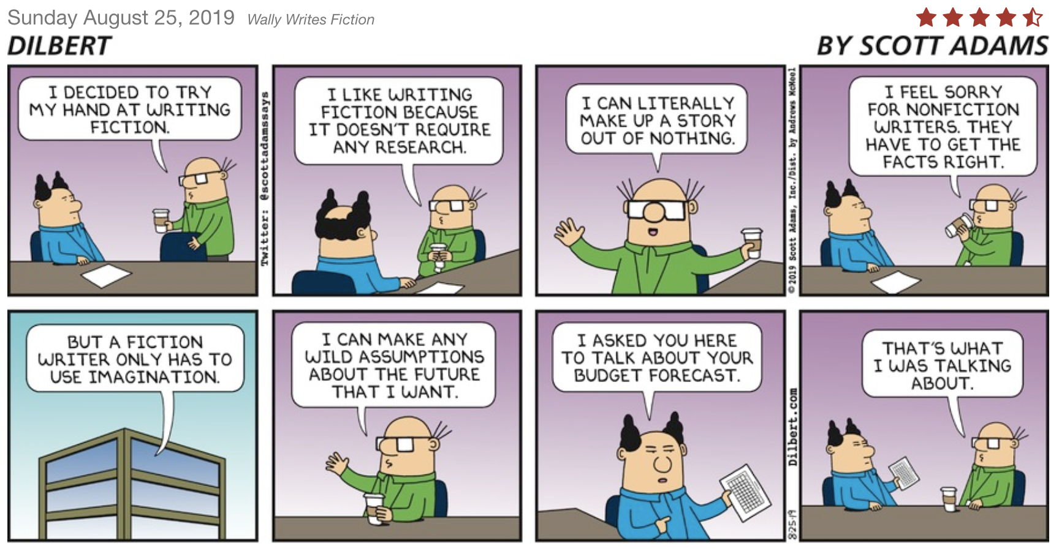

Slide 3
Houston, we have a (Spending) Problem…
…but it’s not what you think it is!

Slide 4
Do we have A “Spending Problem”?
We heard from various outside groups that Utah government spending has outstripped inflation and population.
Source: Budget of the State of Utah, Office of the Legislative Fiscal Analyst.

Slide 5
Do we have A “Spending Problem”?
We heard from various outside groups that Utah government spending has outstripped inflation and population.
Accounting for inflation and population growth, this is TRUE.
Source: Budget of the State of Utah, Office of the Legislative Fiscal Analyst.

Slide 6
Do we have A “Spending Problem”?
We heard from various outside groups that Utah government spending has outstripped inflation and population.
Accounting for inflation and population growth, this is TRUE.
”State Only” sources have also grown significantly in the past 20 years.
“General Revenue” includes General Fund (sales tax), Education Fund (Income tax), Transportation Fund (gas tax) and sales tax earmarked for Transportation.
Source: Budget of the State of Utah, Office of the Legislative Fiscal Analyst.

Slide 7
Do we have A “Spending Problem”?
We heard from various outside groups that Utah government spending has outstripped inflation and population.
Accounting for inflation and population growth, this is TRUE.
”State Only” sources have also grown significantly in the past 20 years.
Though growth has been in education, transportation, and social services.
“General Revenue” includes General Fund (sales tax), Education Fund (Income tax), Transportation Fund (gas tax) and sales tax earmarked for Transportation.
Source: Budget of the State of Utah, Office of the Legislative Fiscal Analyst.

Slide 8
What’s Growing?
Using index anchored in 1998, we can see where growth is occurring relatively.
All sources triple over 20 years.
General Revenue grows 2.5 times.
Public Education tracks General Revenue.
Higher Education tracks General Revenue.
Social Services grows faster than General Revenue.
Transportation grows faster than everything.
”All Other” spending grows most slowly.

Slide 9
Do we have A “Spending Problem”?
We heard from various outside groups that Utah government spending has outstripped inflation and population.
Accounting for inflation and population growth, this is TRUE.
”State Only” sources have also grown significantly in the past 20 years.
Though growth has been in education, transportation, and social services.
On a real per-capita basis, general revenue spending has been quite flat for 20 years.
“General Revenue” includes General Fund (sales tax), Education Fund (Income tax), Transportation Fund (gas tax) and sales tax earmarked for Transportation.
Source: Budget of the State of Utah, Office of the Legislative Fiscal Analyst.

Slide 10
Spending Controls Already Exist…
…and legislators are enhancing them.

Slide 11
State Appropriations Limitation (UCA 63J-3)
Non-exempt growth limited to 1985 spending levels indexed for inflation and population growth
Transportation exempted
Education exempted
Limit adjusted for federal programs assumed by state (Medicaid, etc.)
Auditor must annually audit limit and amounts subject to limit then “notify appropriate officials of corrective action.”

Slide 12
History of Approps Limit

Slide 13
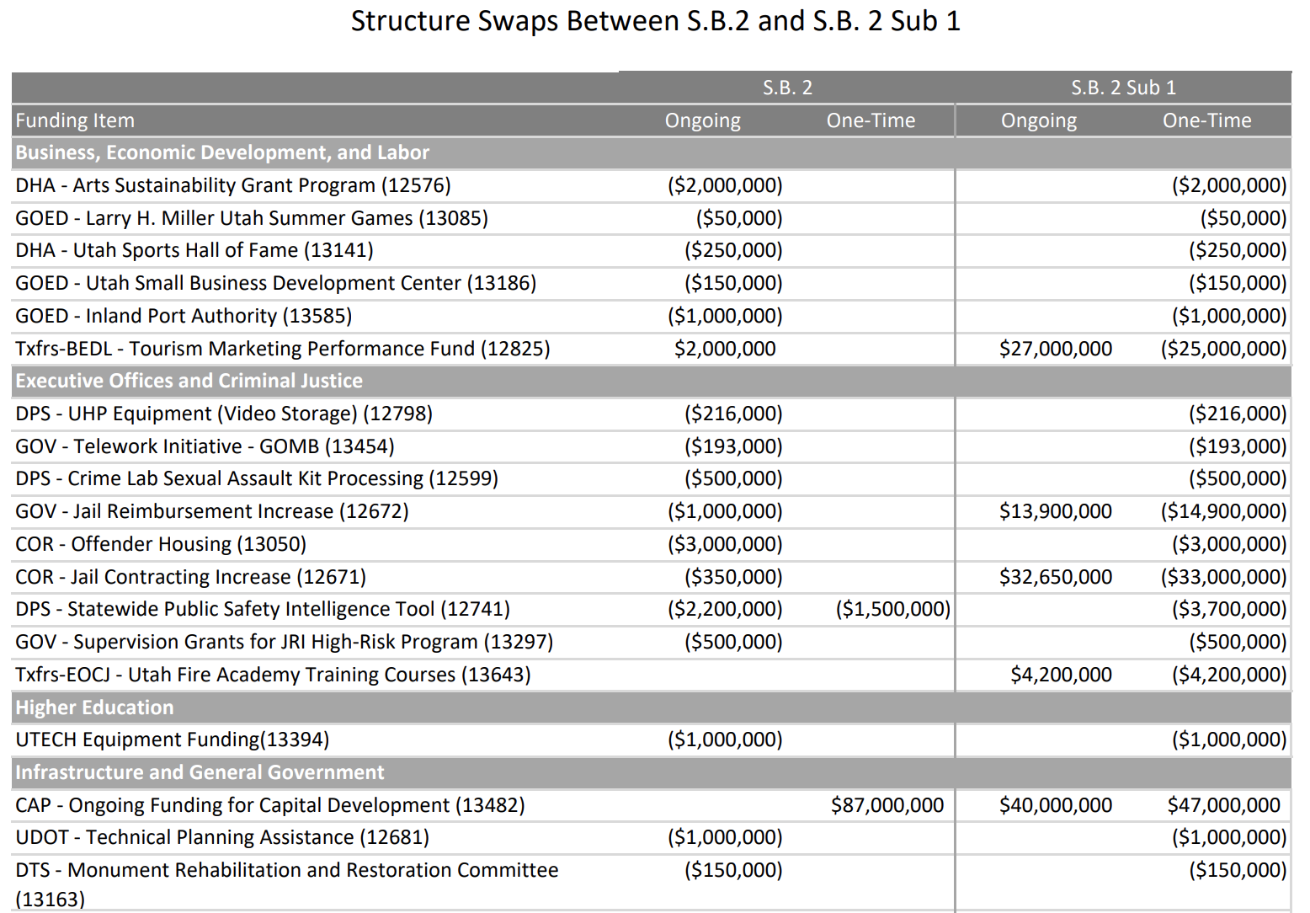
Automatic Spending Cuts Established
When the Legislature failed to make progress on tax reform in the 2019 General Session, they:
Created the Tax Restructuring and Equalization Task Force
Decelerated General Fund spending in Higher Education to buy more time (House Bill. 3)
Set more than $300 million in automatic spending cuts triggered if Task Force fails to make progress (1st Substitute Senate Bill 2).

Slide 14
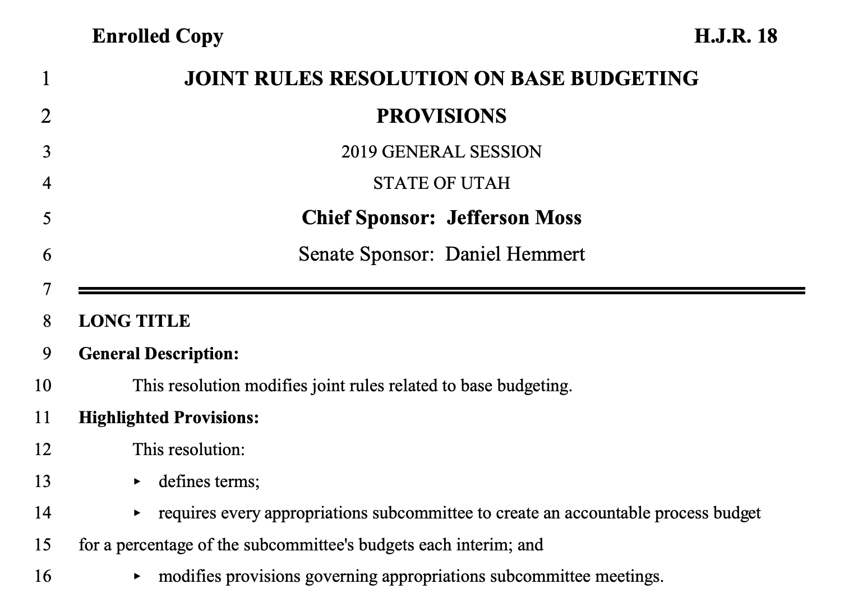
Zero-Based Budgets required
”Accountable Process Budgets” reset 20% of base budgets each year – 100% over five years.
Subcommittees spend Interim Session scrutinizing base budgets starting from zero.
Result in base budget separate from formulaic “last year’s ongoing” base.
Requirement passed in 2019 General Session.
Appropriations Subcommittees currently formulating accountable and traditional base budgets.

Slide 15
Conclusions
Total state budget from all sources is growing faster than inflation and population.
General revenue budget (GF, EF, TF, TIF) about flat on a real per-capita basis.
Education, social services, and transportation driving growth – all others lagging.
Controls on spending currently exist.
Spending is addressed in appropriations subcommittees.

Slide 16
Public Education Budget
Understanding Utah’s School Funding System
September 2019

Slide 17
Legal Authority: Utah Code
53F-2-103: Public Education System - Purpose
Equity
All children are entitled to reasonably equal educational opportunities regardless of residence or economic situation of their school district
State & Local Participation
Providing a public education is primarily a state function; school districts should be required to pay a portion of the cost of a minimum program
Local Control & Determination
School districts are empowered to provide educational facilities and opportunities beyond the minimum program (Basic School Program)
Latitude of action is permitted and encouraged
Title 53E – PED State Administration
Title 53F – PED Funding
(53F-2: Minimum School Program)
Title 53G – PED Local Administration
Notes:
Statute outlines three objectives to Utah’s education funding system:

Slide 18
Total Revenues As Reported by School Districts & Charter Schools
FY 2018
$6.2 Billion
Reported in AFR
Excludes State Agencies
State Sources – 55%
Local Sources – 38%
Federal Sources – 7%
Does Not Include State Administration

Slide 19
Revenue: Utah Compared to the Nation FY 2016 | Percent of Public Education Revenue by Source

Slide 20
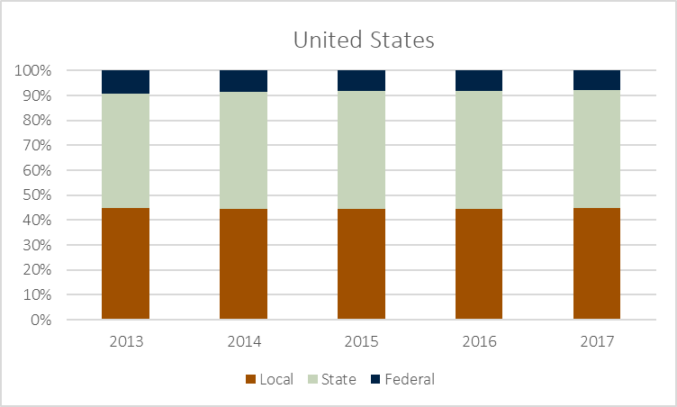
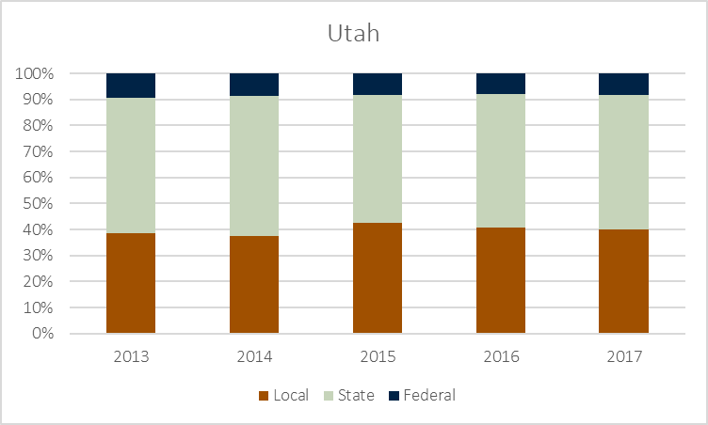
Revenue: Utah Compared to the Nation FY 2013-2017 | Percent of Public Education Revenue by Source

Slide 21
Total Expenditures As Reported by School Districts & Charter Schools
FY 2018
$6.8 Billion
Reported in AFR
Excludes State Agencies
Employee Compensation – 61%
Does Not Include State Administration

Slide 22
Expenditures: Utah Compared to the Nation FY 2016 | Percent of Public Education Expenditures by Major Category

Slide 23
Expenditures: Utah Compared to the Nation FY 2017 | Operating Expenditures on Instruction, Support Services, Other

Slide 24
Expenditures: Utah Compared to the Nation FY 2017 | Capital Expenditures on Buildings & Equipment

Slide 25
State Funding for Public Education Summary | State Revenue Allocated to Local Education Agencies (LEAs)
Minimum School Program
Primary Source of State Funding to Locals
Include Weighted Pupil Unit (WPU) Programs
Multiple Programs to Equalize Local Property Tax Collections
School Building Program
Minimum State Funding Programs for Capital
State Board of Education
Receives State Funding Appropriation from Legislature
Executes Statutory Formulas or Determines Distribution by Rule
“Passes-Through” MSP/SBP/Other Funding to Locals
Notes:
What does “Equity” in an education finance system mean?
“Equity” often used to mean “Equal Funding per Student”
This is not Equity, but “Equality”
“Equity” is much more complex and needs to factor individual student needs and varying cost structures.
Equalization is the process used to make something equal – or providing equity.
State educational finance systems become complex through the process of trying to provide “Equity”.

Slide 26
State Funding for Public Education Minimum School Program | The Basic School Program
Utah’s Foundation Funding Formula
Provides Majority of Operating Revenue to Locals
Weighted Pupil Unit (WPU)
Number of WPUs – Student/Program Counts (Statute)
WPU Value – Dollar Amount Paid per WPU (Legislature)
“Above-the-Line”
Fully Equalized
State & Local Property Tax Interaction
Locals Must Impose Basic Levy to Participate
State Revenue Used to Equalize Local Property Tax
Based on Total Cost of Program for the Local Entity
How is Local Revenue Equalized?
Notes:
What does “Equity” in an education finance system mean?
“Equity” often used to mean “Equal Funding per Student”
This is not Equity, but “Equality”
“Equity” is much more complex and needs to factor individual student needs and varying cost structures.
Equalization is the process used to make something equal – or providing equity.
State educational finance systems become complex through the process of trying to provide “Equity”.

Slide 27
Basic School Program: Funding Equalization
Recapture
Tax proceeds that exceed the cost of the basic program “shall be paid into the Uniform School Fund as provided by law.” (53F-2-301)

Slide 28
State Basic Rate: “Basic Levy”
Revenue Target Set by Legislature
Generates Est. $509.5 M in FY 2020
$46.6 M more than FY 2019
Uniform Statewide Property Tax Rate
Estimated by Legislature – 0.001661
2018 Equity Pupil Rate – Holds Rate at 0.0016 (FY 2022)
2018 WPU Value Rate – Rate Floats Above 0.0016 for Inflation
Based on Prior Year State/Local Revenue Mix to Basic Program
Actual rate set by the Tax Commission – 0.001661
Legislature Subject to Truth-in-Taxation Requirements, Not Locals
Basic Rate has Four Components
In order to qualify for receipt of the state contribution toward the basic program and as its contribution toward its costs of the basic program, each school district shall impose a minimum basic tax rate per dollar of taxable value. . . (53F-2-301.5)

Slide 29
The Basic Levy: The Four Components FY 2020
Target: $509,484,600
Components:
Basic Levy
Increment (2015) – $75.0 M
Equity Pupil (2018) – Difference Between Rate of 0.0016 Minus “Minimum Basic Tax Rate”
WPU Value (2018) – Maintain State/Local Funding Ratio at 15% when WPU Value is Increased

Slide 30
1994-96 Rate Reductions:
Account for Statewide Re-Valuation on Property by Local Assessors
Change in the Primary Residence Exemption – from 32% to 45%
2015 & 2018 Rate Increases:
Legislative Efforts to Address State/Local Funding Mix in the Basic School Program
Notes:
Since 2000, the Basic Rate has decreased 15% (from 0.001881 to 0.001596)
Hit the lowest rate in 2008 at 0.001250
This is 33% lower than 2000
2017’s Rate is 28% higher than 2008
Revenue generated from the rate has increased from $204.8 million in 2000 to $399.0 million in 2017.
Increase of $194.2 million (Increase of 95%)
Large rate decrease in 1994 to 1996 (See Table)
Legislature adopted property tax reductions over two years
Adjusted to account for a statewide re-valuation effort by local assessors
Change in the primary residence exemption – 32% to 45%

Slide 31
State Funding for Public Education Minimum School Program | The Related to Basic School Program
Programs Support the Basic School Program
“Below-the-Line” not Funded by WPUs
Legislature Can Target Funding for Specific Groups (Students/Teachers) or Statewide Educational Need
Transportation, Teacher Salaries, Youth-in-Custody, etc.
Digital Teaching & Learning, Student Health & Counseling
Programs not Universal to All LEAs
Locals Qualify (Formula) or Apply (Grant)
Fully Funded from State Education Funds
Notes:
What does “Equity” in an education finance system mean?
“Equity” often used to mean “Equal Funding per Student”
This is not Equity, but “Equality”
“Equity” is much more complex and needs to factor individual student needs and varying cost structures.
Equalization is the process used to make something equal – or providing equity.
State educational finance systems become complex through the process of trying to provide “Equity”.

Slide 32
State Funding for Public Education Minimum School Program | Voted & Board Local Levy Programs
State-Supported Property Tax Guarantee Programs
School District Must Levy Property Tax
Voted – by Vote of Electorate
Board – by Vote of Local Board of Education
To Qualify for State Funding, Revenue Collection Must Be Lower than State Guarantee Rate
Legislature Sets the Guarantee Rate Annually
FY 2020 Rate = $44.98
Guarantee is for Each WPU and Each Tax Increment
Up to 20 Tax Increments (Rate of 0.0001)
Partially Equalized (20 out of 45 Increments)
Notes:
What does “Equity” in an education finance system mean?
“Equity” often used to mean “Equal Funding per Student”
This is not Equity, but “Equality”
“Equity” is much more complex and needs to factor individual student needs and varying cost structures.
Equalization is the process used to make something equal – or providing equity.
State educational finance systems become complex through the process of trying to provide “Equity”.

Slide 34
Local Funding for Public Education Summary | Locally Generated Revenues
Primarily Property Tax Revenue
Legislature Authorized 5 Primary Levies
Basic Levy – Mandatory to Participate in MSP
Voted Local Levy – Optional
Board Local Levy – Optional
Capital Local Levy – Optional
Debt Service Levy – Optional
Property Tax Revenue Stays with District
State Formulas Use Local Collections in Distributing State Revenues
Basic, Voted, & Board
“Local (State Budget)” = Local Revenue in State Formulas
Other Sources Included in “Local”
Student Fee Revenue, Tuition, etc.
Notes:
What does “Equity” in an education finance system mean?
“Equity” often used to mean “Equal Funding per Student”
This is not Equity, but “Equality”
“Equity” is much more complex and needs to factor individual student needs and varying cost structures.
Equalization is the process used to make something equal – or providing equity.
State educational finance systems become complex through the process of trying to provide “Equity”.

Slide 35
Local Funding for Public Education Property Tax | Rates, Statutory Caps, & Available Capacity
Tax Rates Determined by Local Boards of Education
Legislature Sets Maximum Rate in Statute
No Cap on Debt Service Rate | Rate Set to Repay Debt
Some Districts May Exceed Cap Through Certified Tax Rate Process to Generate Prior-Year Revenue Amount
Revenue Generated Varies by District Based on Taxable Value of Property
Most Tax Rates Lower than Statutory Caps
Est. $1.1 Billion Available Capacity in FY 2019
See “School District Property Tax Revenues” for Detail by School District
Notes:
What does “Equity” in an education finance system mean?
“Equity” often used to mean “Equal Funding per Student”
This is not Equity, but “Equality”
“Equity” is much more complex and needs to factor individual student needs and varying cost structures.
Equalization is the process used to make something equal – or providing equity.
State educational finance systems become complex through the process of trying to provide “Equity”.

Slide 37
Federal Funding for Public Education Summary | Federal Revenue Supporting Education Programs
Federal Funds Primarily Support Five Functions
Special Education
Child Nutrition Programs
Title Programs (Economically Disadvantaged)
Vocational Education
Teacher Quality
Some Additional Minor Grants
Adult Ed, English Learners, State Assessments, etc.)
State Board Receives Funding and Distributes to Locals
Comparatively Utah Receives Fewer Federal Funds as a Percent of Budget
Notes:
What does “Equity” in an education finance system mean?
“Equity” often used to mean “Equal Funding per Student”
This is not Equity, but “Equality”
“Equity” is much more complex and needs to factor individual student needs and varying cost structures.
Equalization is the process used to make something equal – or providing equity.
State educational finance systems become complex through the process of trying to provide “Equity”.

Slide 38
constitutional earmark of income tax
Tax Restructuring and Equalization Task Force
September 5, 2019

Slide 39
Utah’s Income tax earmark Utah Const. Art. x, sec. 5(5)
“All revenue from taxes on intangible property or from a tax on income shall be used to support the systems of public education and higher education as defined in Article X, Section 2.”

Slide 40
Article x, section 2
“The public education system shall include all public elementary and secondary schools and such other schools and programs as the Legislature may designate. The higher education system shall include all public universities and colleges and such other institutions and programs as the Legislature may designate. Public elementary and secondary schools shall be free, except the Legislature may authorize the imposition of fees in the secondary schools.”

Slide 41
Timeline of Utah’s constitutional Income tax earmark
Constitutional amendment to separately define the “higher education system” and “public education system”
SJR 1 (1986)
1909
Enacted income tax earmark -
75% to education
SJR 2 (1930)
1946
1996
Adopted constitutional funding levels for public education
SJR 2 (1909)
Increased income tax earmark to 100%
HJR 2 (1946)
Repealed constitutional funding levels for public education
HJR 1 (1946)
Added higher education to income tax earmark
SJR 17 (1996)
1930
1986

Slide 42
Language over time
1930 | “All revenue received from taxes on income or from taxes on intangible property shall be allocated as follows: 75 per cent thereof to the State district school fund and 25 per cent thereof to the State general fund and the State levies for such purposes shall be reduced annually in proportion to the revenues so allocated; provided that any surplus above the revenue required for the State district school fund as provided in Section 7 of this Article shall be paid into the State general fund.”
1946 | “All revenue received from taxes on income or from taxes on intangible property shall be allocated to the support of the public school system as defined in Article X, Section 2 of this Constitution.”
1996 (current) | “All revenue received from taxes on income or from taxes on intangible property shall be allocated to the support of the public education system and the higher education system as defined in Article X, Section 2 of this Constitution.”

Slide 43
Education-related income tax earmarks in Other states
44 states have a state income tax
9 states earmark some portion of income tax revenue for education
3 states earmark income tax revenue for education by state constitution
Amounts vary
Other states earmark portions of other revenue sources for education

Slide 44
Education-related income tax earmarks in Other states
State | Earmark Description | Citation | Percentage Dedicated, 2005 (NCSL)
Utah* | 100% of income tax revenue to public and higher education | Utah Const. Art. XIII, sec. 5 | 100%
Alabama | Nearly all income tax revenue dedicated to public and higher education | Ala. Code § 40-18-58 | 97.9%
Michigan | A percentage of gross income tax revenue for school districts, higher education, and school employee retirement | Mich. Comp. Laws § 206.51 | 32.5%
Oklahoma | A portion of income tax revenue earmarked for teacher retirement and education reform programs | Okla. Stat. Tit. 69 §§ 2352; 2355.1B | Corporate: 20.3% Individual: 12.1%
New York | An amount necessary to fund the School Tax Relief Program (provides eligible homeowners relief from property taxes) | N.Y. Law § 97-rrr | 10.9%
Ohio* | A portion of income tax revenue collected by the state is returned to local school districts | Ohio Const. Art. XII, sec. 9 | Unclear, less than 9%
Colorado* | 0.033% of taxable income for public education | Colo. Const. Art. IX, sec. 17 | 7.8%
Arkansas | Portion of corporate income tax revenue for improvement of state post-secondary technical colleges and schools | Ark. Code §§ 19-6-301; 26-51-205 | 4.2%
Idaho | 50% of income tax paid on state lottery winnings for public school substance abuse programs | Idaho Code § 40-18-58 | 0.5%
*earmark provided by state constitution
Notes:
http://www.ncsl.org/documents/fiscal/earmarking-state-taxes.pdf

Slide 45
Past proposals not adopted (1997 to Present)
2019 General Session S.J.R. 3 (McCay/Stratton)
Allow income tax revenue to be used to provide services for the poor, disabled, and elderly
2016 General Session S.J.R. 4 (Dabakis)
Repeal 1996 amendment by prohibiting use of income tax revenue for higher education

Slide 46
Historical impact of education earmark
Historically there has not been a strong correlation between income tax revenue changes and public education appropriation changes.
Policymakers smooth revenue volatility to provide relatively stable funding for public education throughout the business cycle.

Slide 47
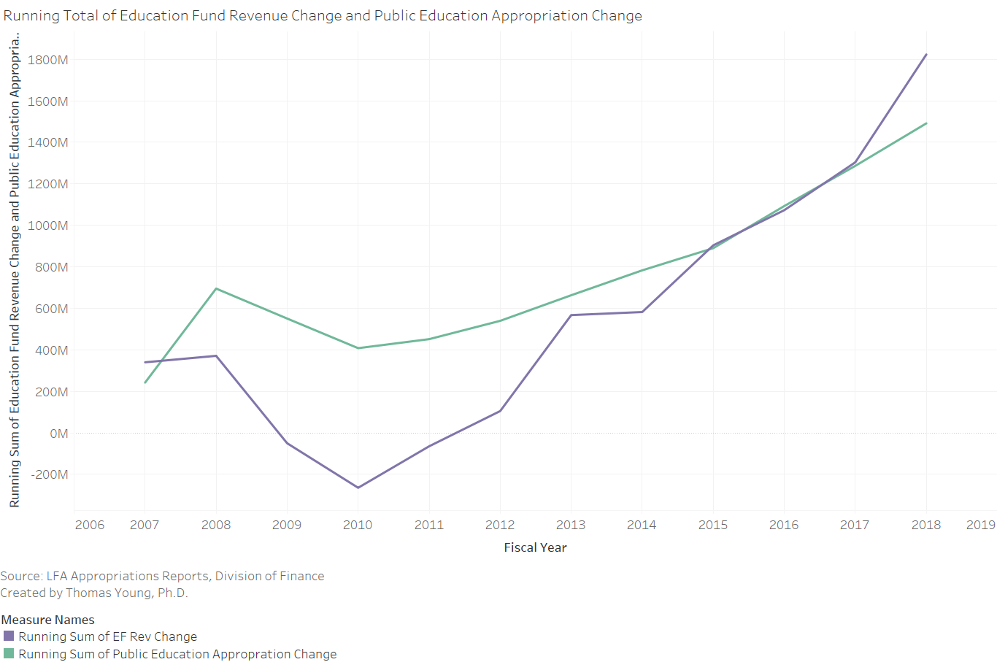

Slide 48
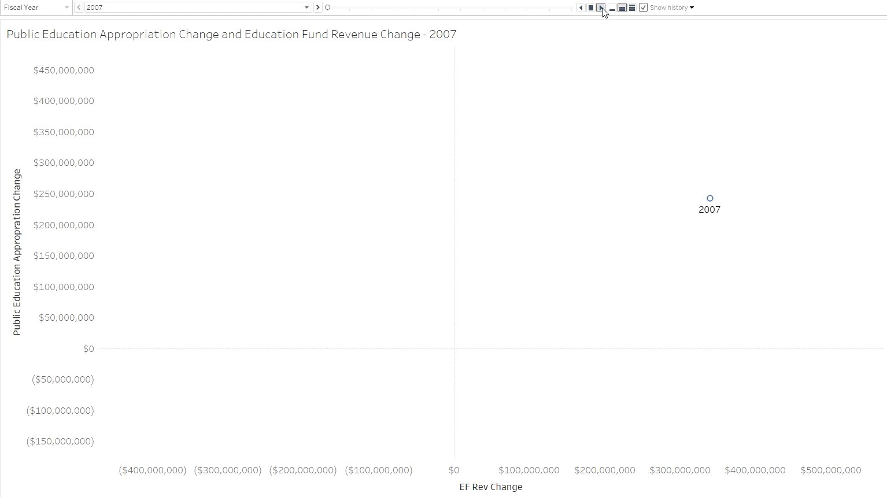

Slide 49
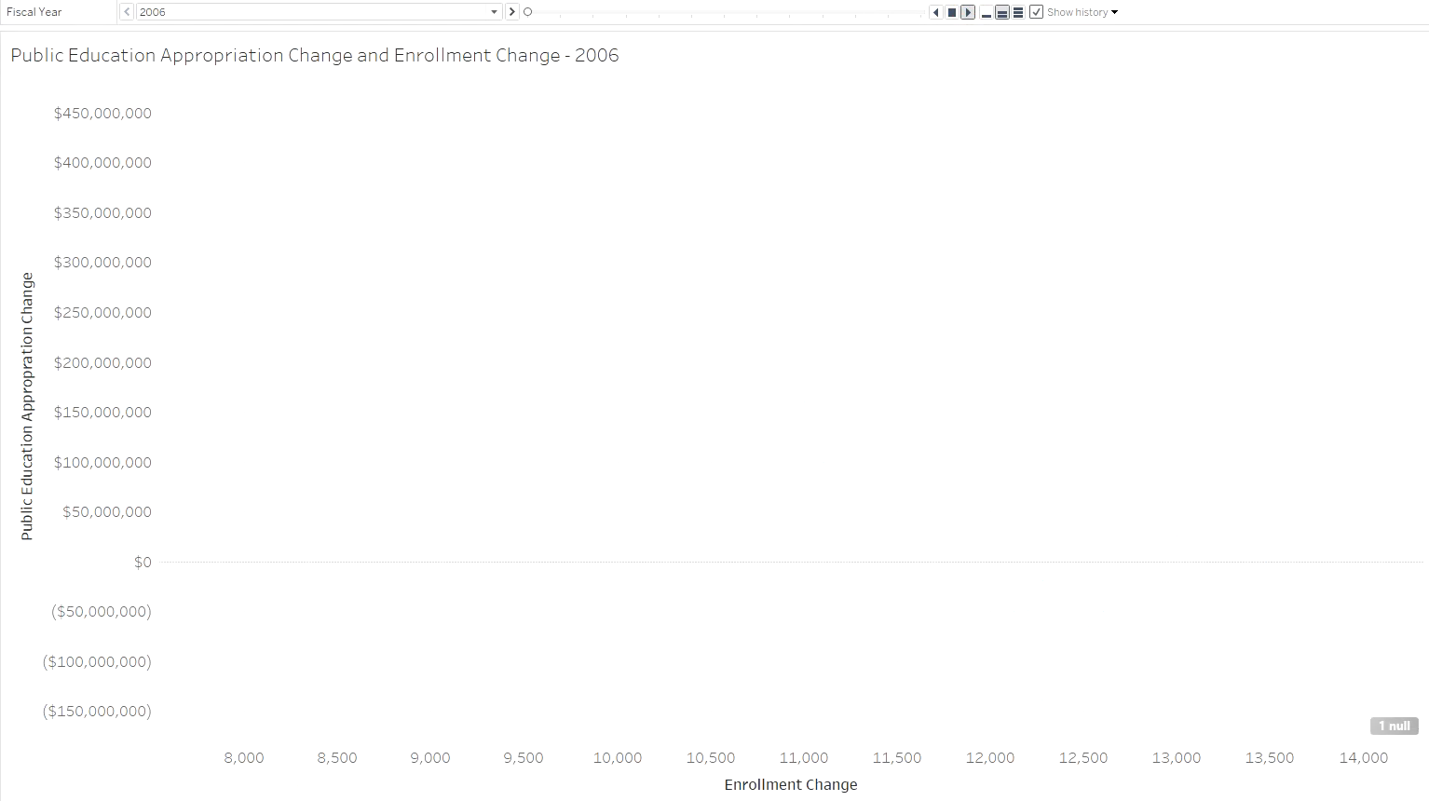

Slide 50
% of STATE FUNDING ALLOCATED TO PUBLIC EDUCATION
Year | Public Ed App. | Total Apps.
1997 | $1,405,957,300 | $2,995,340,677
1998 | $1,409,418,600 | $3,024,606,099
1999 | $1,475,584,400 | $3,247,024,399
2000 | $1,520,850,083 | $3,365,199,721
2001 | $1,638,443,500 | $3,698,122,200
2002 | $1,715,613,360 | $3,713,553,140
2003 | $1,649,769,194 | $3,525,477,594
2004 | $1,687,960,774 | $3,574,635,974
2005 | $1,795,954,311 | $3,987,904,711
2006 | $1,885,024,075 | $4,248,757,275
2007 | $2,127,285,045 | $5,037,179,385
2008 | $2,580,025,308 | $6,043,604,578
2009 | $2,435,769,286 | $5,001,673,736
2010 | $2,293,037,886 | $4,462,410,936
2011 | $2,336,560,886 | $4,724,470,836
2012 | $2,423,182,891 | $4,858,716,000
2013 | $2,548,056,500 | $5,126,789,800
2014 | $2,667,994,000 | $5,402,220,000
2015 | $2,770,438,000 | $5,748,913,000
2016 | $3,038,257,000 | $6,263,668,000
2017 | $3,246,330,000 | $6,427,338,000
2018 | $3,447,706,000 | $6,682,792,000
2019 | $3,566,671,000 | $7,043,441,400
2020 | $3,799,115,800 | $7,366,890,600

Slide 51
Policy options
Tax Restructuring and Equalization Task Force
September 5, 2019

Slide 52
Spectrum of potential modifications to allowed uses of income tax
Fund school lunch program out of Education Fund and move liquor markup profits to General Fund
Amend Constitution to eliminate earmark of income tax to public and higher education
Income Tax Filing Fee and corresponding income tax credit
Status Quo
Less budget flexibility More budget flexibility
Amend Constitution to remove Higher Ed spending from Education Fund
Statutory or administrative changes to certain budget appropriations
Replace Basic Levy with a statewide property tax that would flow into the General Fund and replaced with income tax funds
Amend Constitution to allow for certain social services to be funded from the Education Fund (SJR3)

Slide 53
Eliminate spending restrictions on income tax revenue
Policy Description
The Legislature could pass a resolution to amend the constitution to eliminate the spending restrictions that require all income tax revenue to be spent on public and higher education.
The resolution would need a 2/3 majority in both chambers of the legislature and a majority vote in a statewide general election.
National Comparison
Utah only state with 100% of income tax revenue dedicated to education spending.
2 other states dedicate a portion of income tax revenue to education in their state constitution
6 other states dedicate a portion of income tax revenue to education in statute

Slide 54
Policy considerations
Flexibility
This change would provide the Legislature flexibility to use income tax revenue to meet any state need.
Scale
An amendment could be crafted to free up all or a portion of income tax revenue. It could also be crafted to allow income tax revenue to be used for only certain state purposes.
Simplicity/Transparency
Eliminating spending restrictions simplifies the budget process.

Slide 55
Income tax filing fee and credit
Policy Description
The Legislature could impose a fee on each individual or corporation that files an income tax return and deposit the fee in the General Fund. An income tax credit equal to the amount of the fee could offset the cost of the fee to the taxpayer.
This policy would effectively transfer the amount of the fee from the Education Fund to the General Fund.
A fee of $1 per filer would transfer approximately $1.5M.
National Comparison
Idaho requires all individuals and corporations who file an income tax return to pay an additional tax of $10, which goes into a Permanent Building Fund.

Slide 56
Basic school program funded from education fund
Policy Description
The Legislature could adjust the Basic School Program to allow property tax revenue generated by the minimum basic levy to be deposited in the General Fund. An amount equal to the property tax revenue generated by the minimum basic levy could then be sent to local school districts from the Education Fund.
This policy would effectively transfer the amount of revenue generated from the minimum basic levy ($500M in FY21) from the Education Fund to the General Fund.

Slide 57
School Lunch program funded from education fund
Policy Description
The Legislature could fund the School Lunch Program from the Education Fund rather than the revenue generated from 10% of the total gross sales of liquor.
This policy would effectively transfer the amount of revenue generated from 10% of the total gross sales of liquor ($55M in FY21) from the Education Fund to the General Fund.

Slide 58
education programs currently funded from general fund
Policy Description
The Legislature could fund approximately $470 million of education programs from the Education Fund rather than the General Fund.
Examples of such programs include:
Higher Education ($335M)
STEM Action Center – Heritage and Arts ($10.8M)
Education/Training – Corrections ($2.4M)
Rehabilitation Services – Workforce Services ($18.5M)

Slide 59
Income tax credits from Other funds
Policy Description
The Legislature could remove statutory provisions that require income tax credits and donations to be funded from the General Fund or Transportation Fund.
Motor Fuel for Agriculture
$125,465 (Transportation Fund)
Hand Tools Used in Farming
$5,285 (General Fund)
Alternative Fuel Heavy-Duty Vehicles
$208,000 (General Fund)
At-Home Parent
$381,900 (General Fund)
Campaign Fund Contribution
$107,788 (General Fund)

Slide 60
Policy considerations
Scale
Each of these options could be scaled to target specific programs or amounts of revenue to transfer from the Education Fund to the General Fund.
Flexibility
These policies would increase the General Fund, which can be used for any state purpose.
Simplicity/Transparency
Some of these policies simplify the flow of revenue from source to use, while others complicate the flow.
Local Impact
Funding the basic school program from the Education Fund would change the role of local school districts in generating revenue.

Slide 61
Expand the Utah personal exemption
The 2017 Federal Tax Cuts and Jobs Act had the effect of eliminating the personal exemption component of the taxpayer tax credit for Utah personal income tax purposes.
In the 2018 2nd Special Session, the Legislature passed a bill that created the “Utah Personal Exemption,” which reinstated a portion of this provision.
The Legislature could expand the Utah Personal Exemption to help mitigate certain impacts of federal tax changes.
Income phaseouts could be implemented to target the benefit, if desired.

Slide 62
Utah Dependent Personal Exemption
Est. Revenue (FY21) | Est. Growth Trend (CAGR) | Stability Over Time
($136 million) to restore full dependent exemption amount | 3.0% annually | N/A

Slide 63
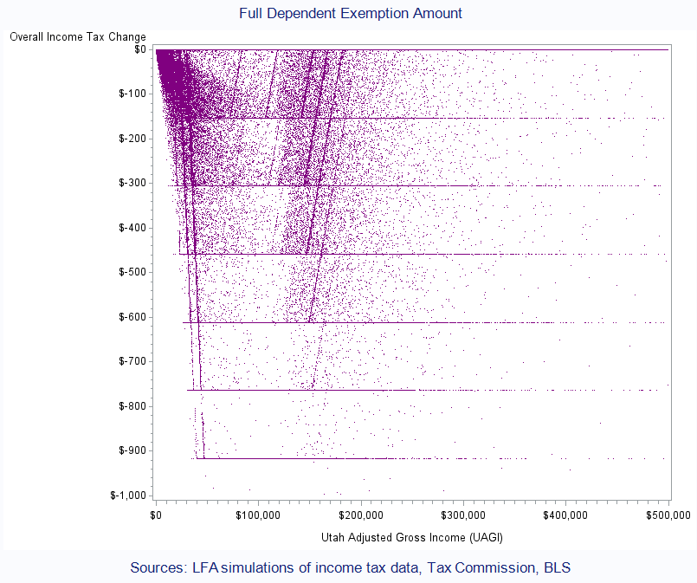

Slide 64
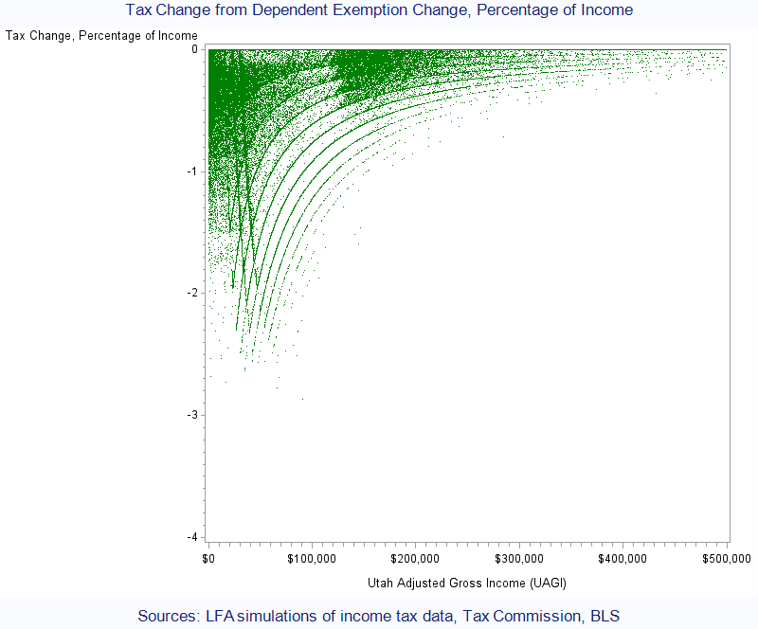

Slide 65
Average impacts
Notes:
Source: U.S. Bureau of Labor Statistics, CPI relative importance tables, www.bls.gov/cpi.
Demographics
Preferences
Industries
Prices

Slide 66
Utah Dependent Personal Exemption,
PHASEOUT
@ 1.5%
Est. Revenue (FY21) | Est. Growth Trend (CAGR) | Stability Over Time
($55 million) to restore full dependent exemption amount 1.5% phase-out (currently @ 1.3%) | 3.0% annually | N/A

Slide 67
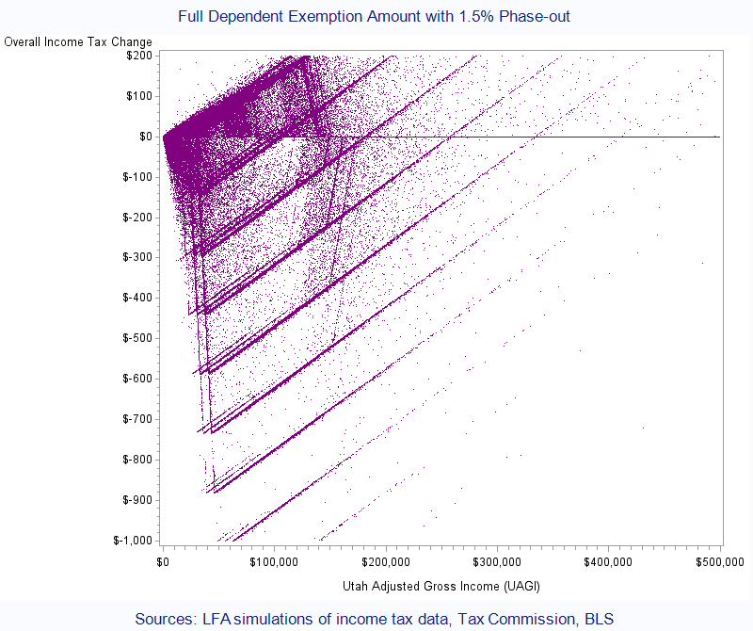

Slide 68
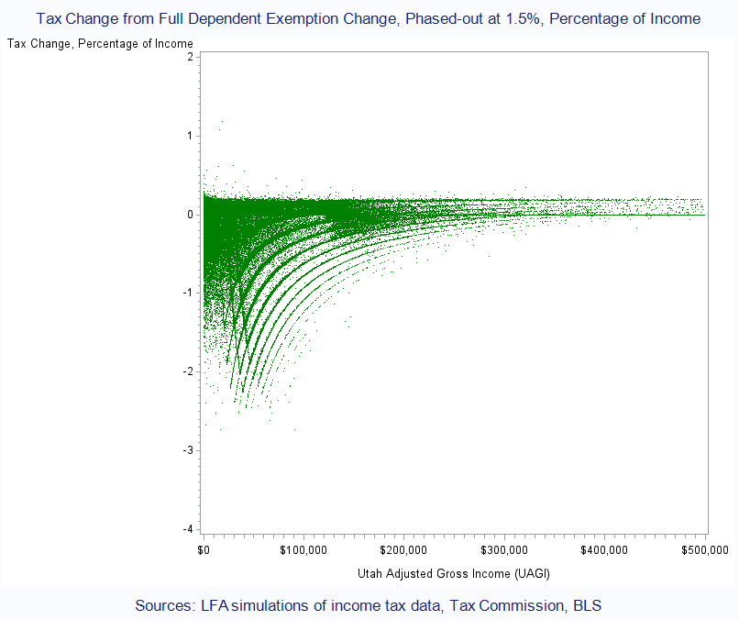

Slide 69
Average impacts
Notes:
Source: U.S. Bureau of Labor Statistics, CPI relative importance tables, www.bls.gov/cpi.
Demographics
Preferences
Industries
Prices

Slide 70
Policy considerations
Scope
Taxpayers with more dependents would benefit more than those with fewer dependents.
The benefit could be targeted more towards low-and-middle-income taxpayers by applying an enhanced income phaseout schedule.
Taxpayers with no dependents would not see a benefit.
Budgetary impact
An increase in the Utah Personal Exemption would reduce revenue in the state’s Education Fund.
Mitigation of federal tax changes impact on state taxes
While many taxpayers saw a reduction in federal taxes from the 2017 federal tax reform, many Utah taxpayers saw an increase in state income tax owed.
Expanding the Utah Personal Exemption would offset that increase for many families.

